Slide 1
α-Snu13p pAC FLAG immunofluorescence microscopy – 20X

Slide 2
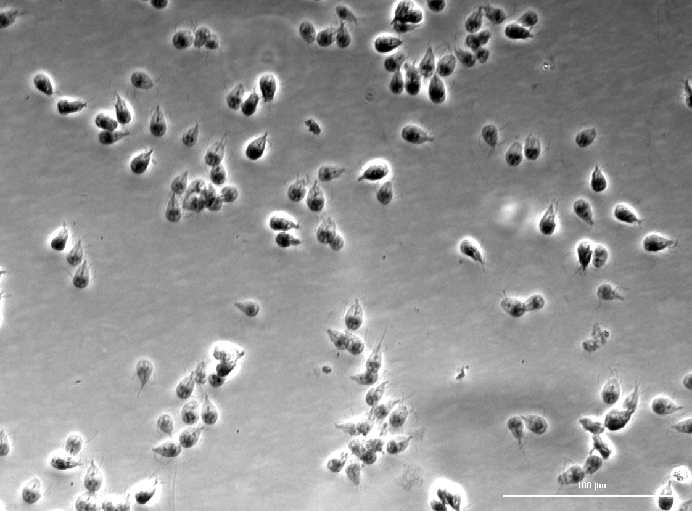

Slide 3
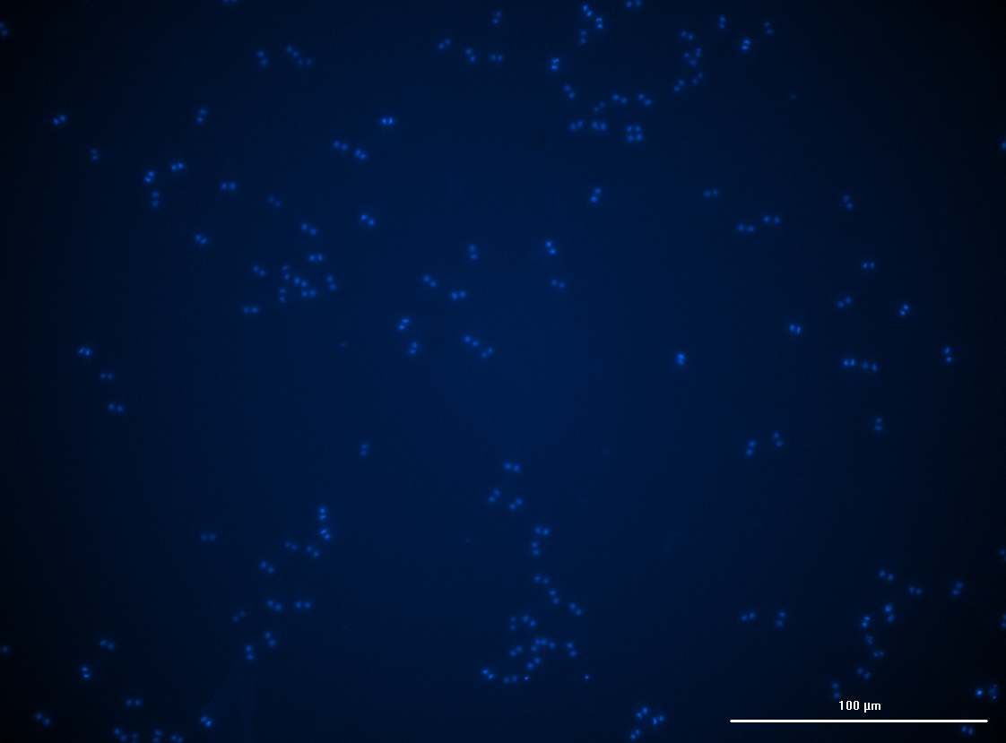

Slide 4
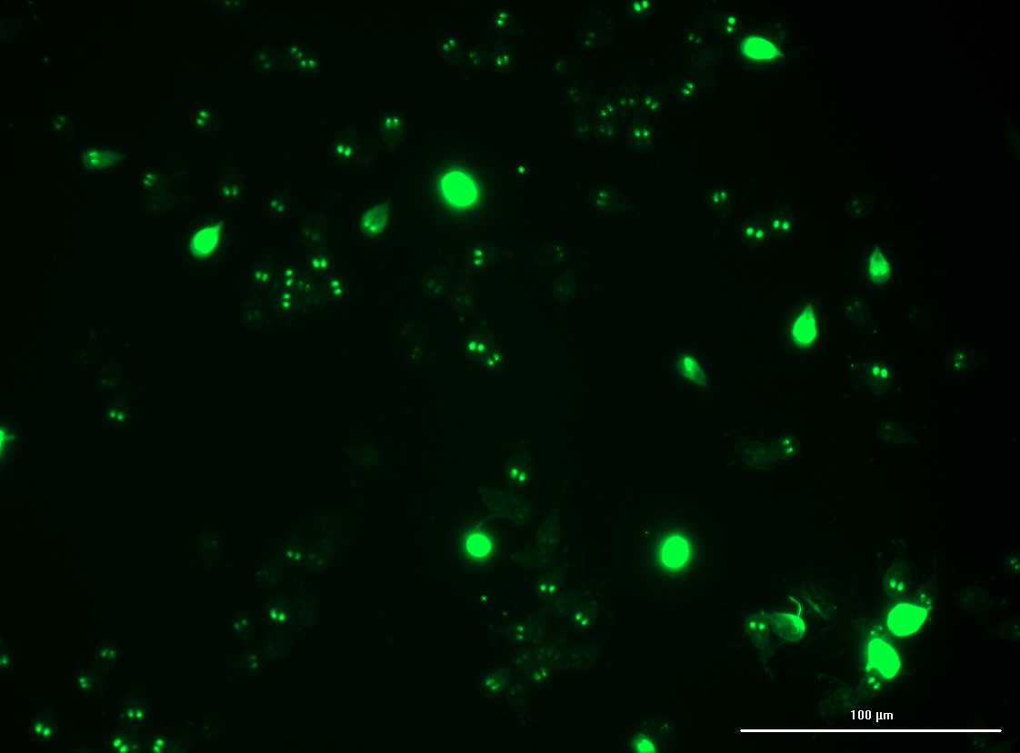

Slide 5
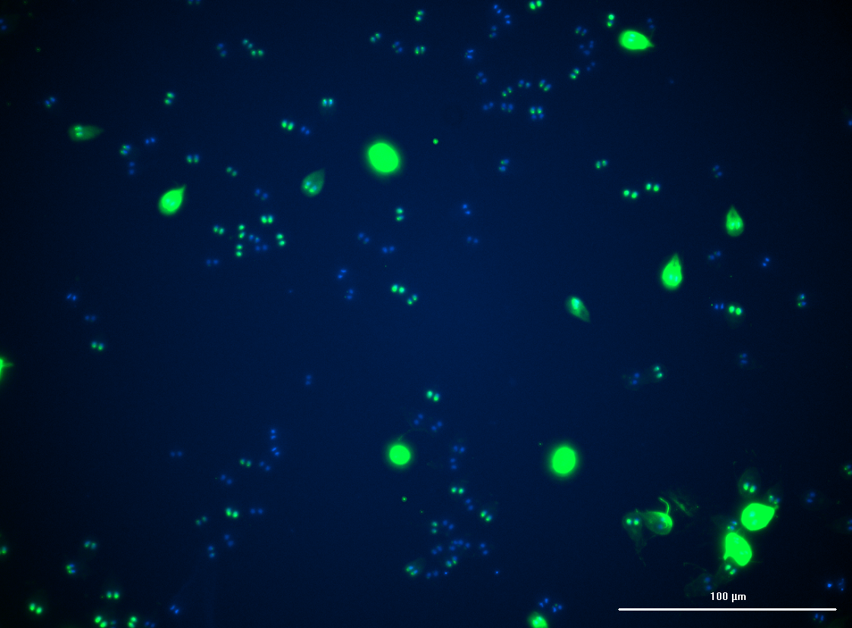

Slide 6
β-Snu13p FLAG immunofluorescence microscopy – 20X

Slide 7
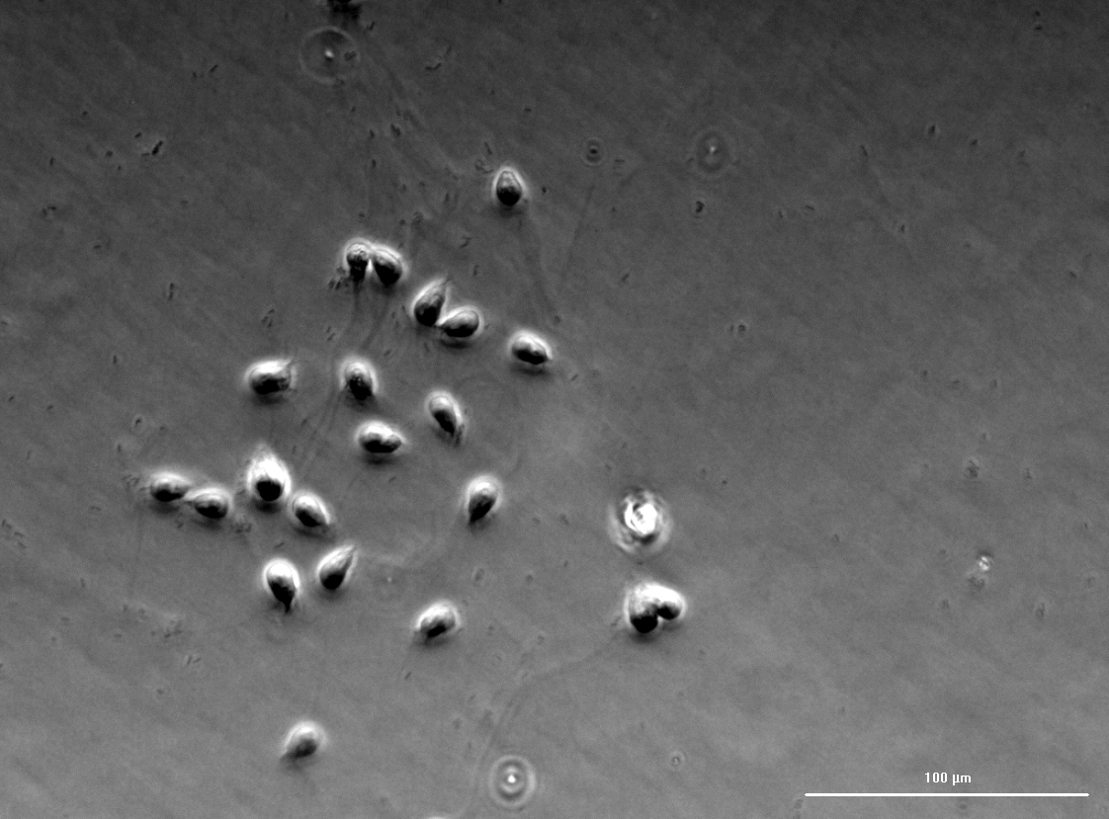

Slide 8
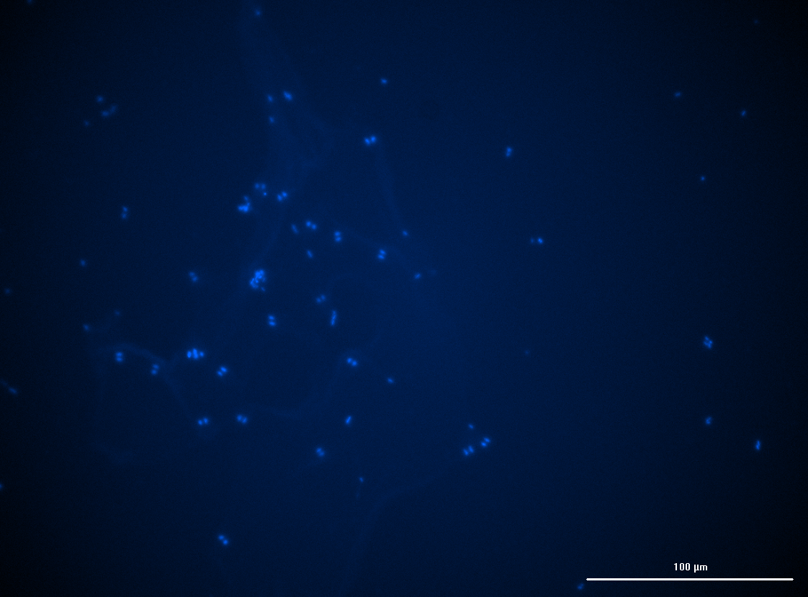

Slide 9
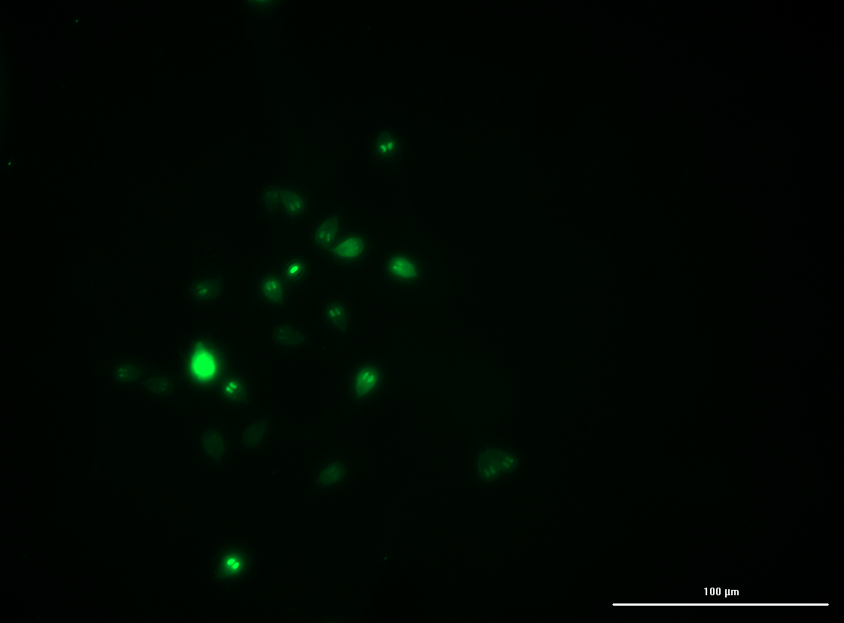

Slide 10
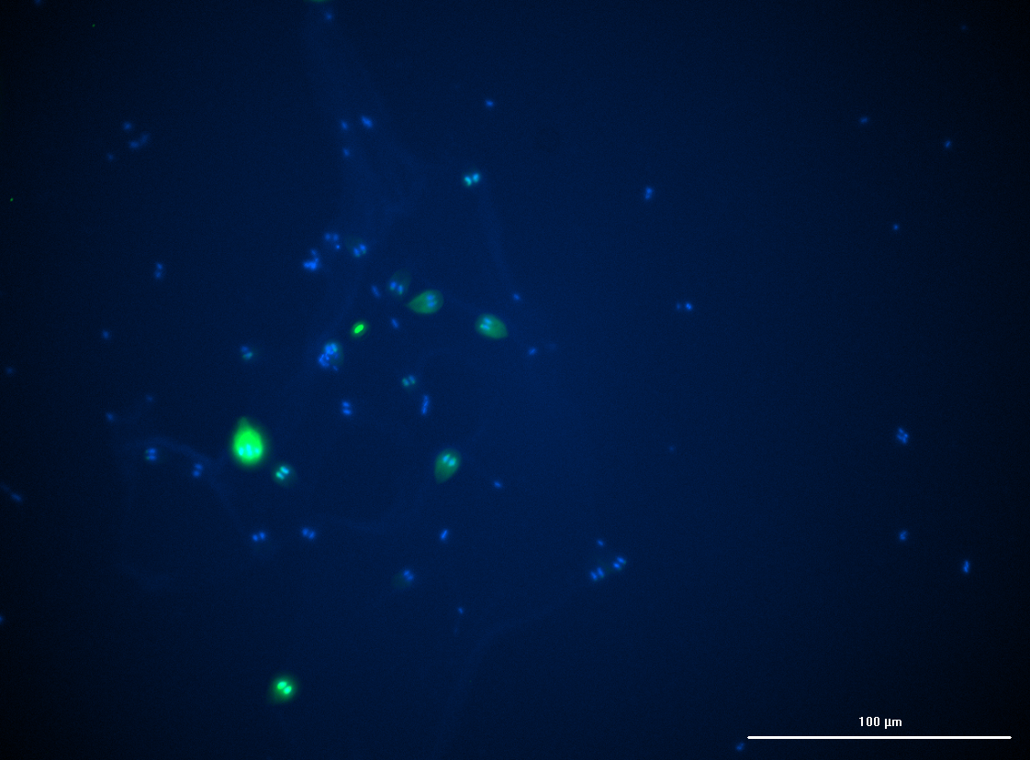

Slide 11
Ucp1 FLAG immunofluorescence microscopy – 20X

Slide 12


Slide 13
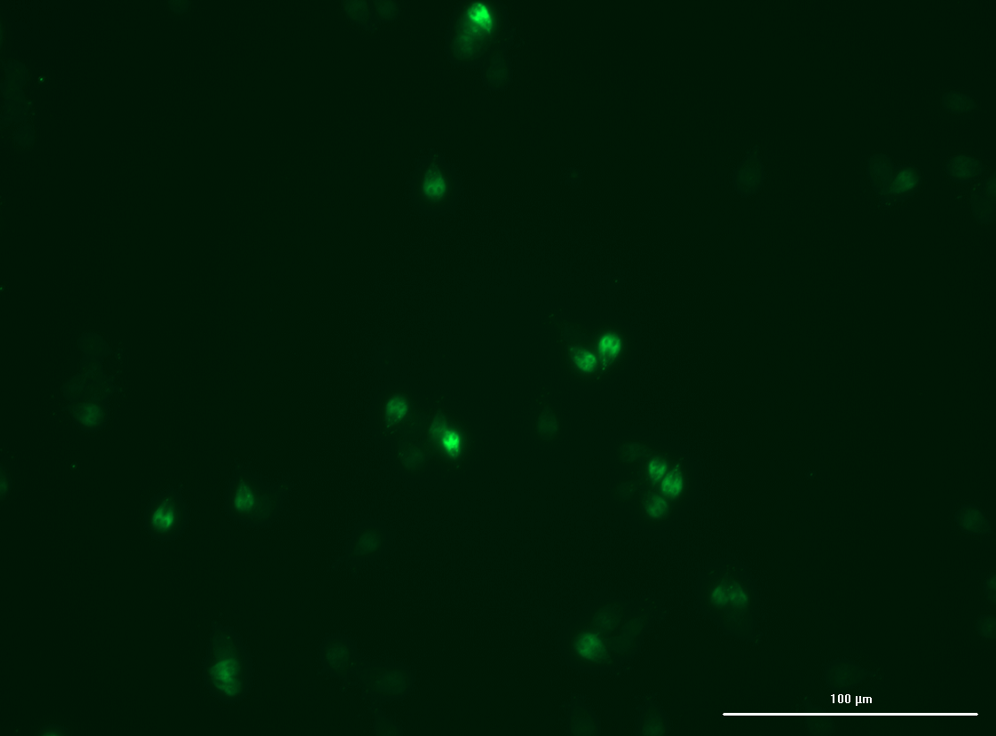

Slide 14
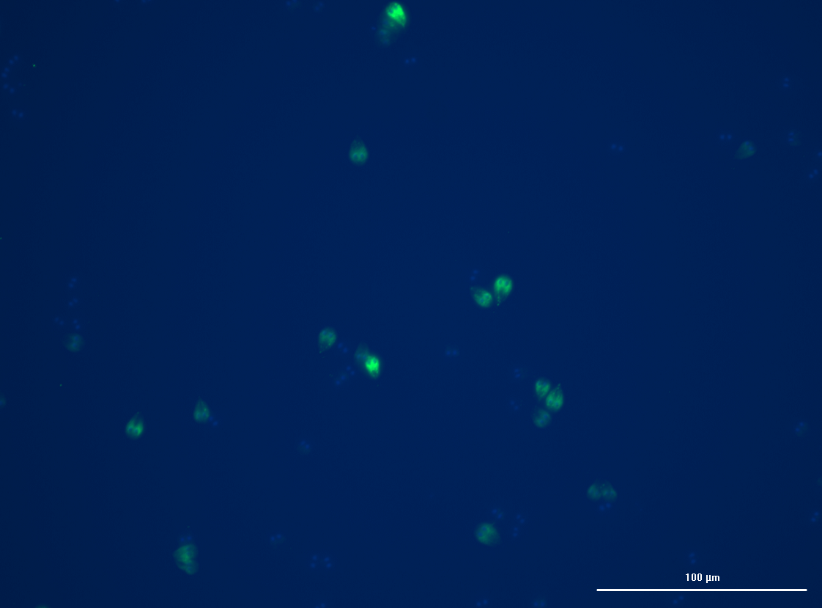

Slide 15
Ucp2 pAN Immunofluorescence microscopy test – 20X

Slide 16
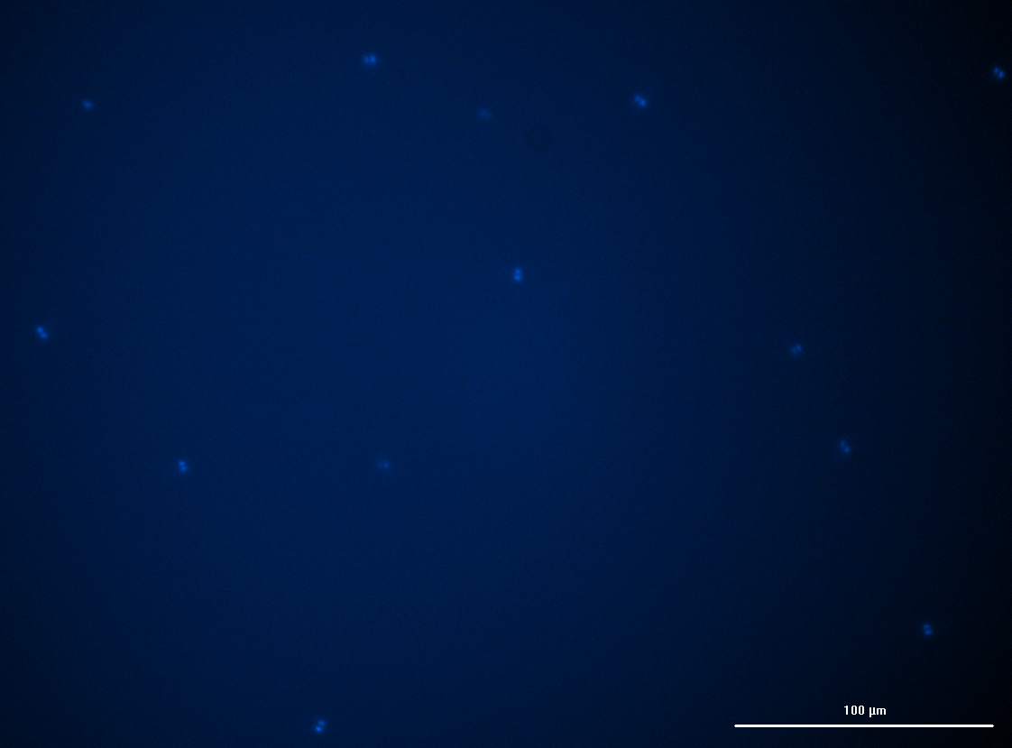

Slide 17
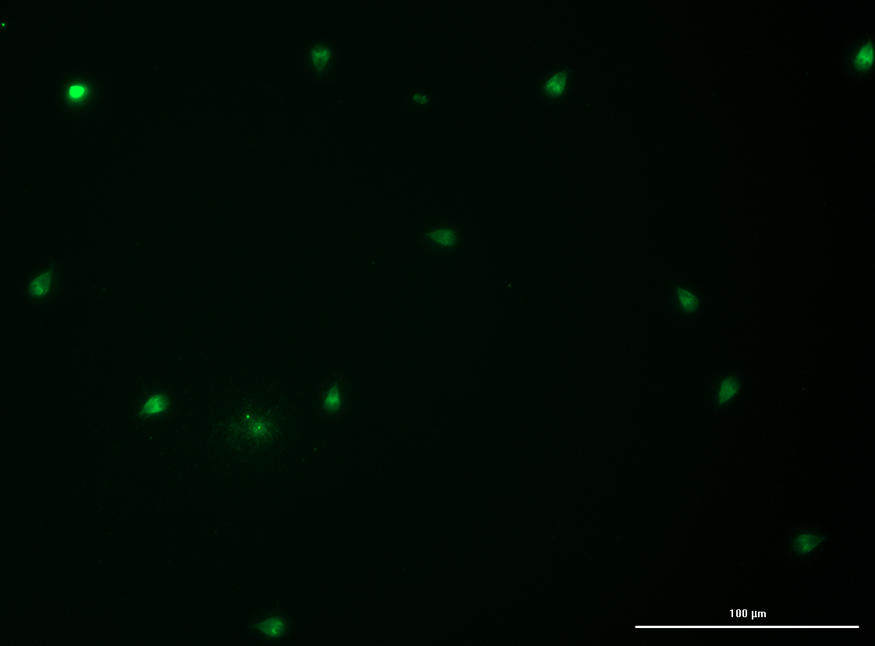

Slide 18
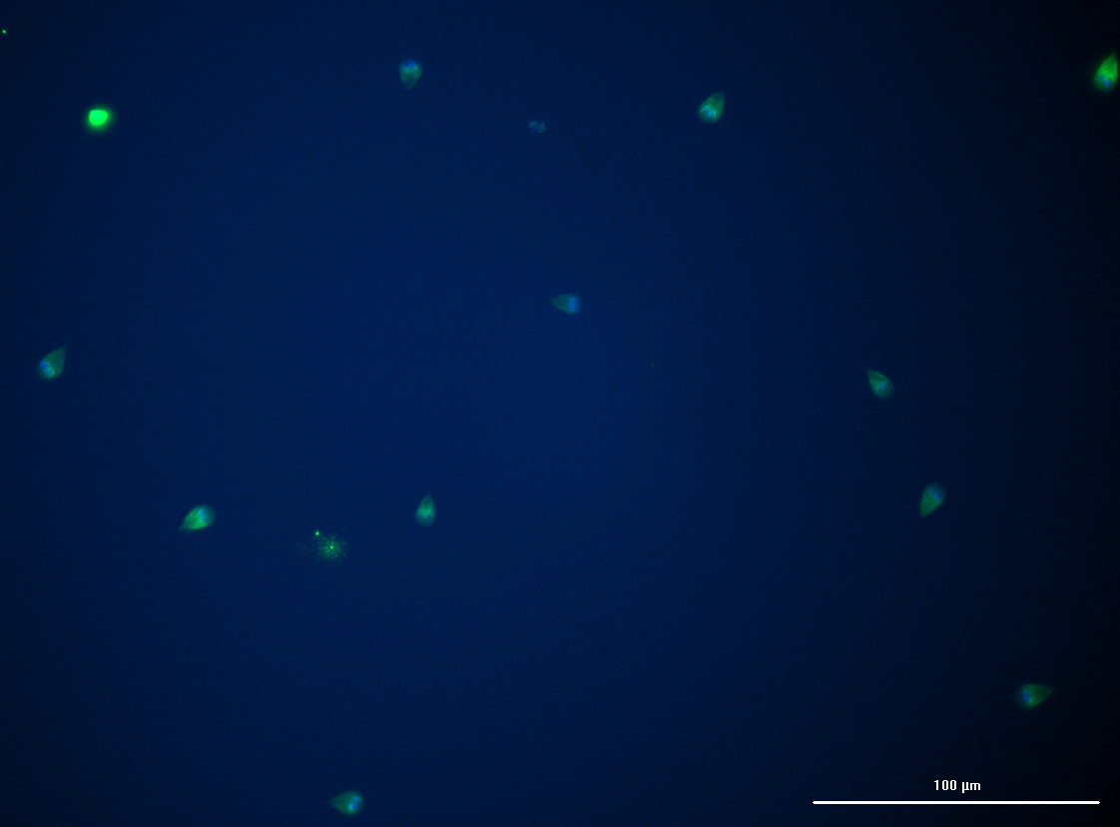

Slide 19
Wild-type Giardia WB C6 control with FLAG primary antibody

Slide 20
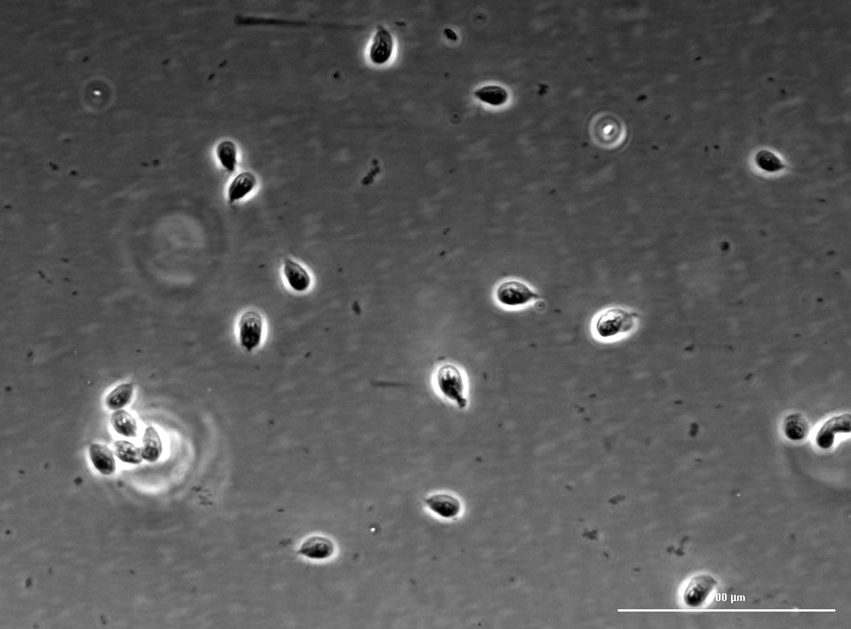

Slide 21
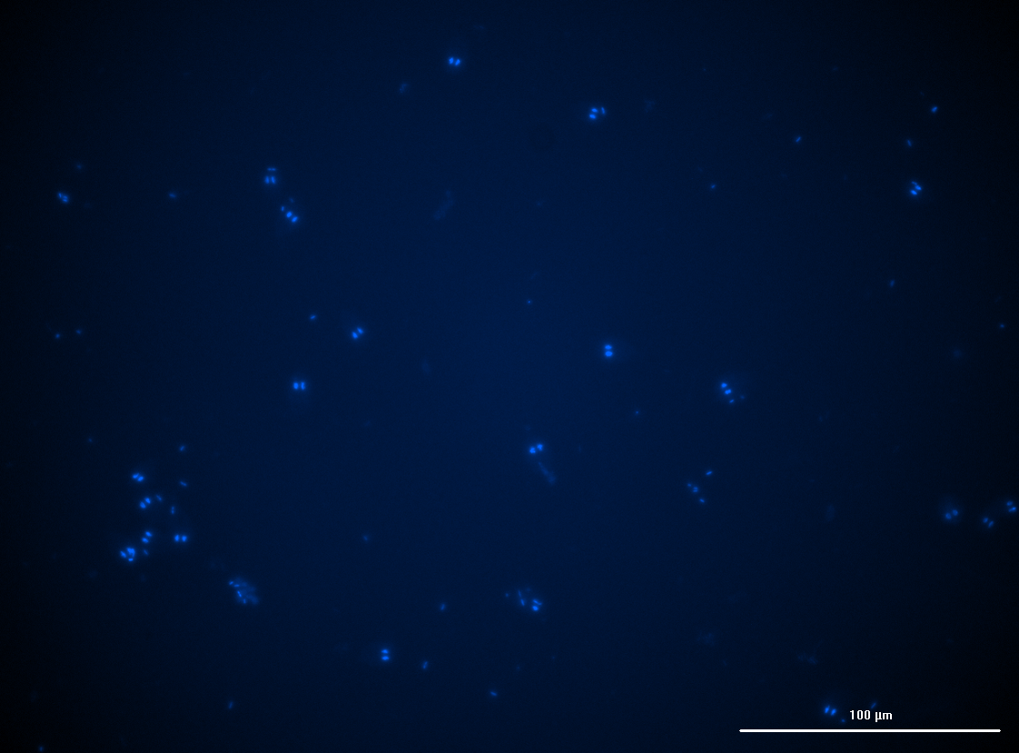

Slide 22
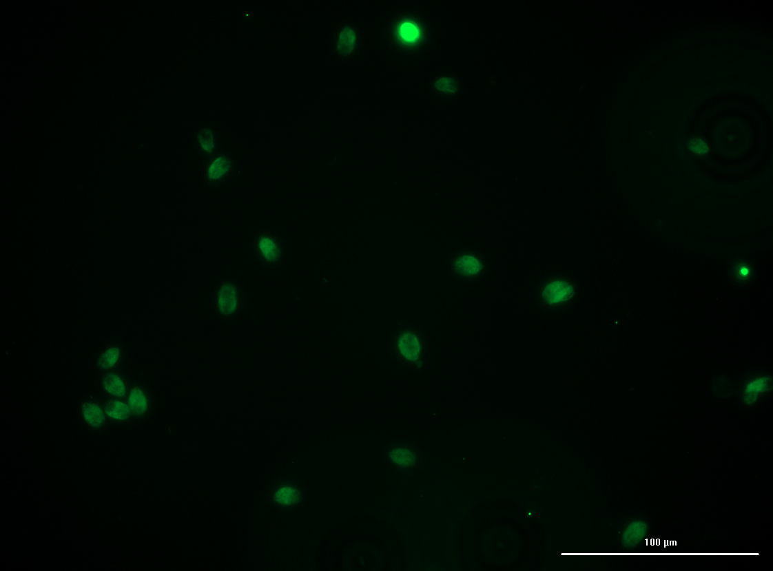

Slide 23
