Slide 1
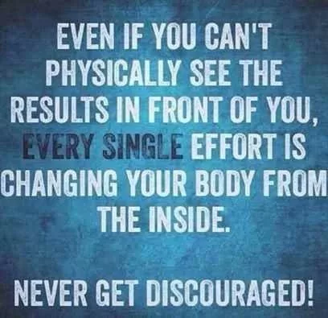
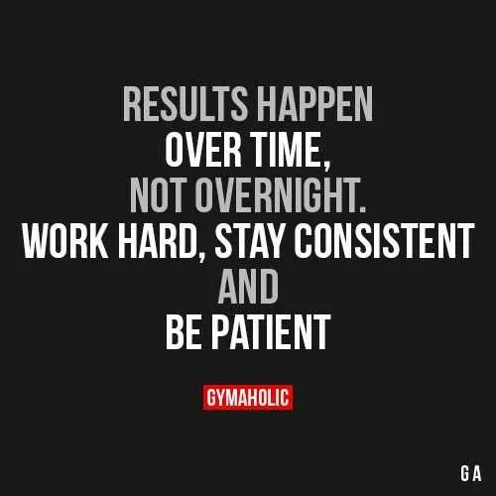
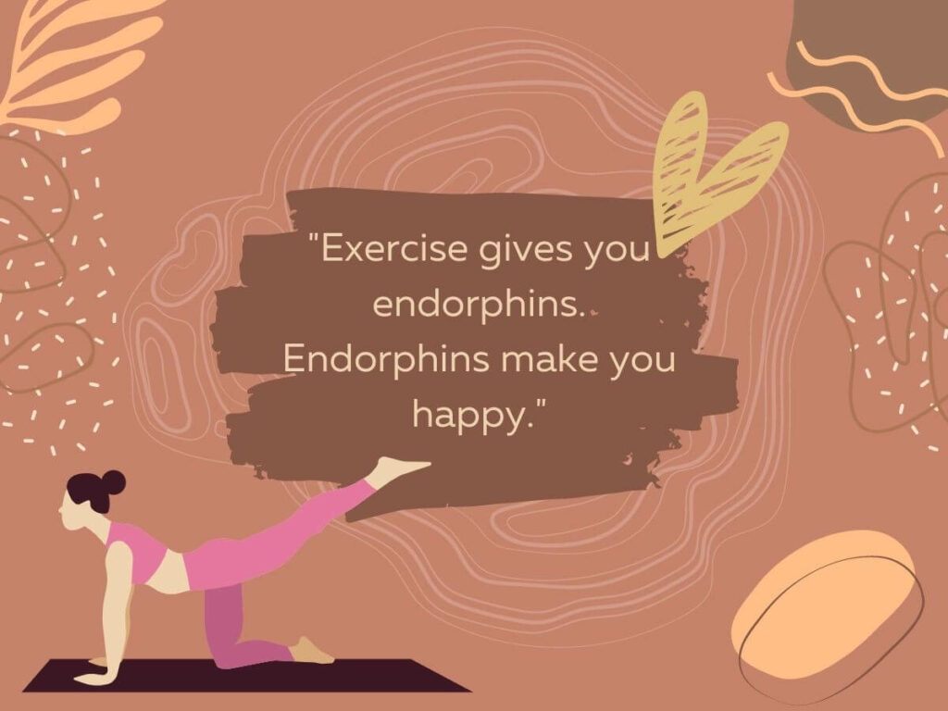

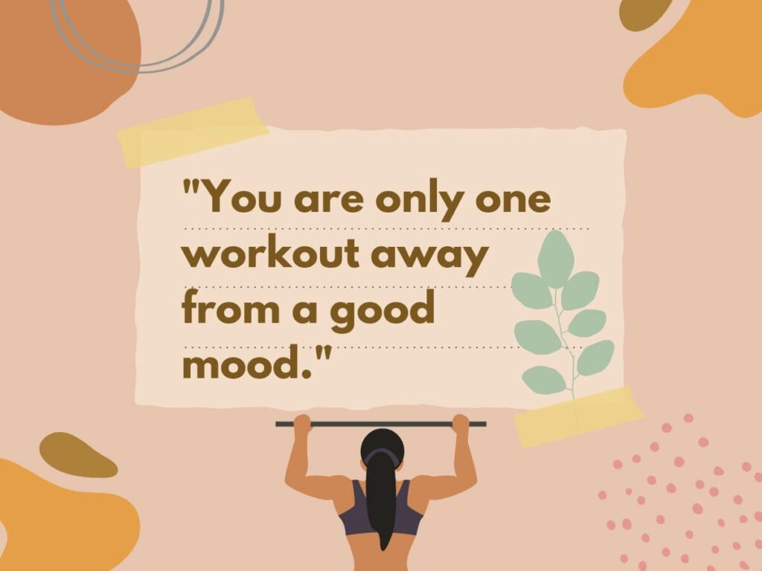
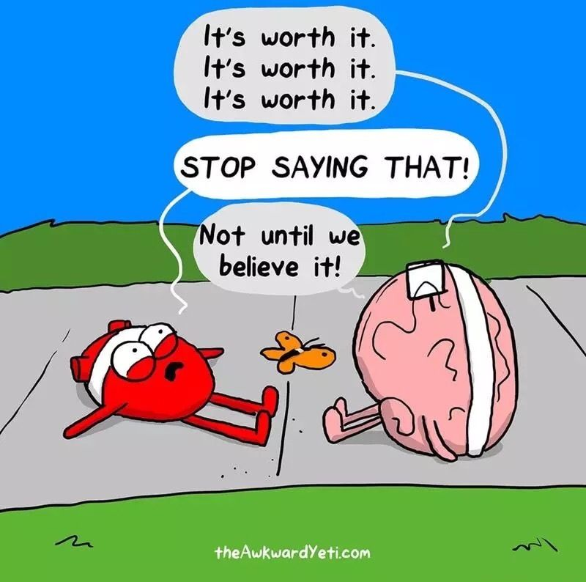
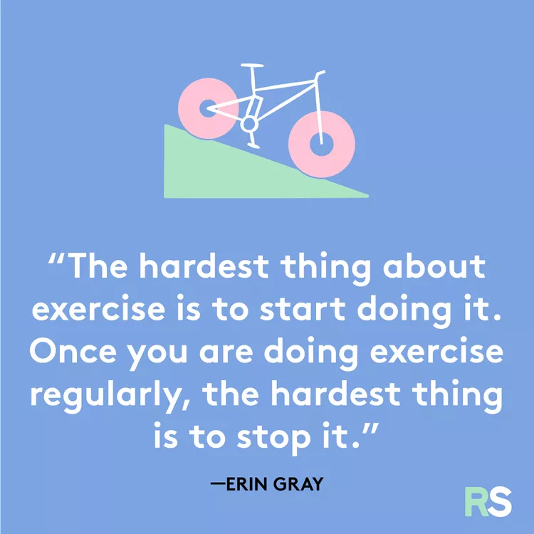
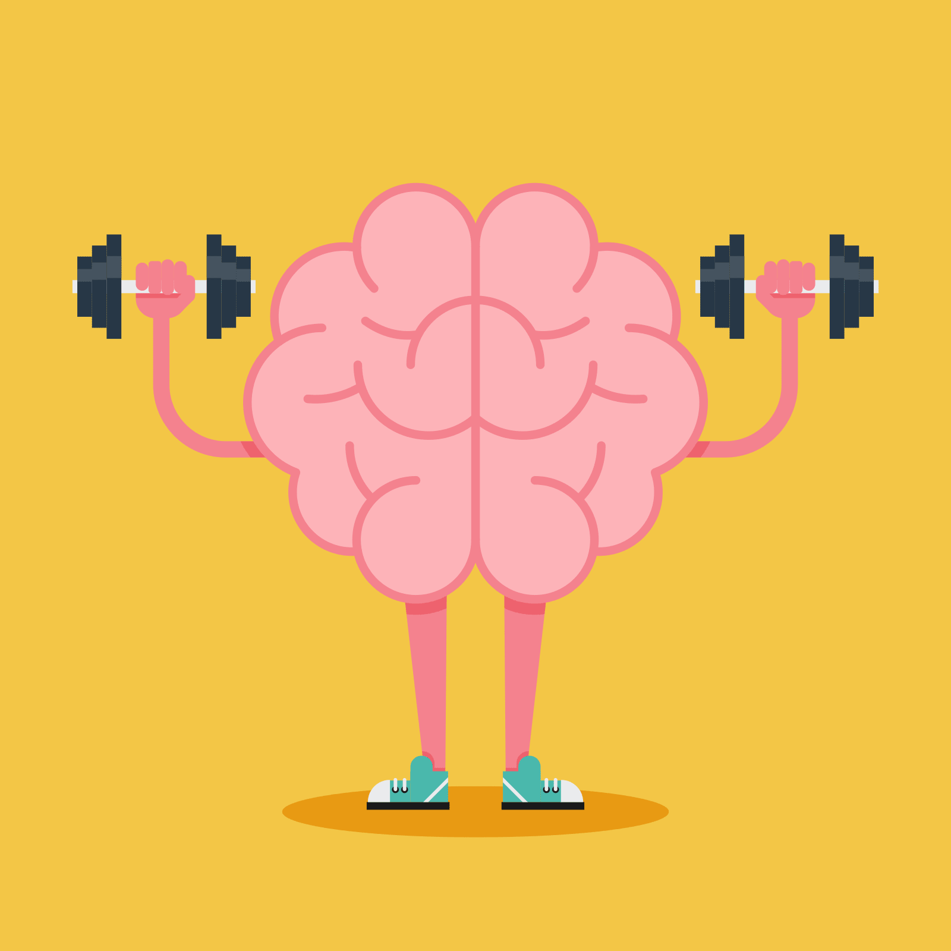
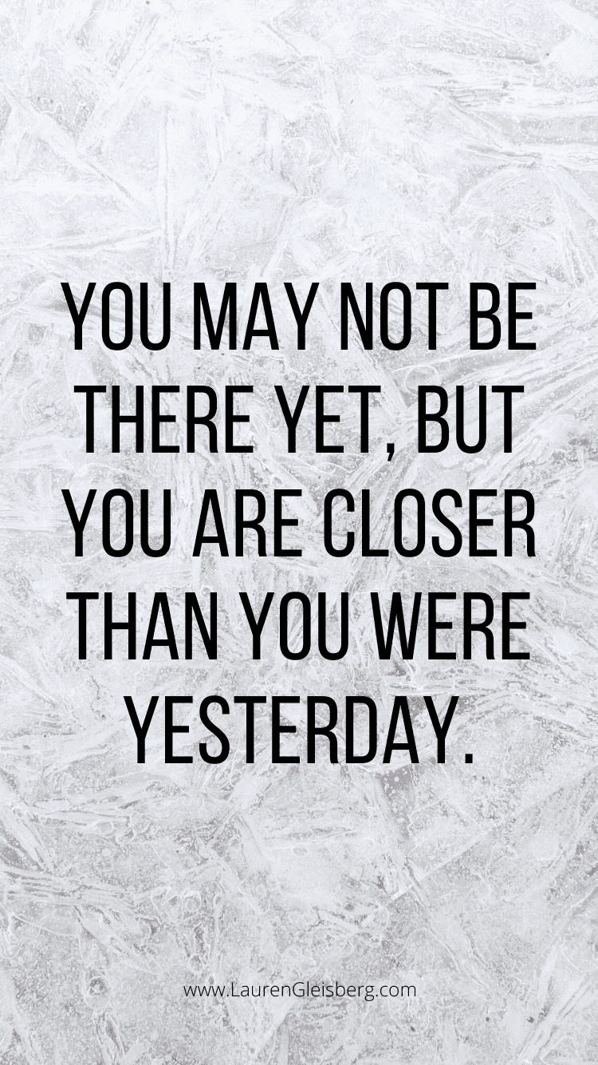
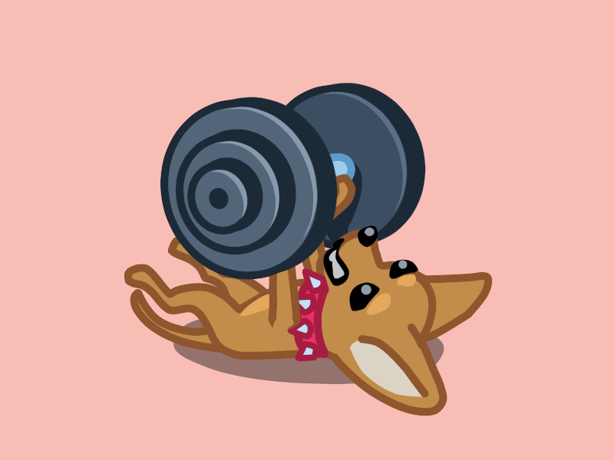
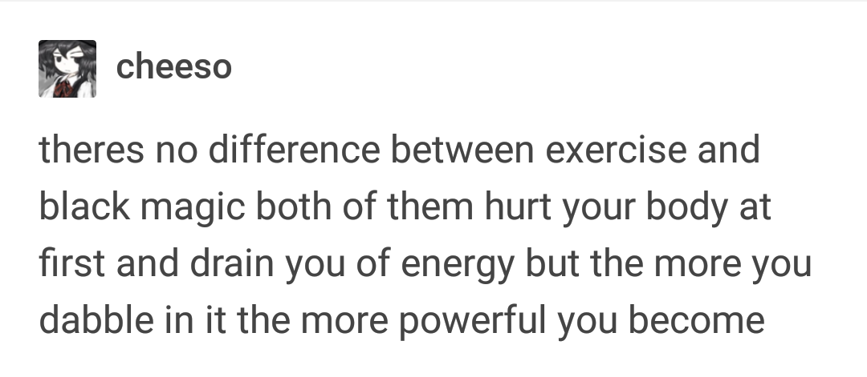
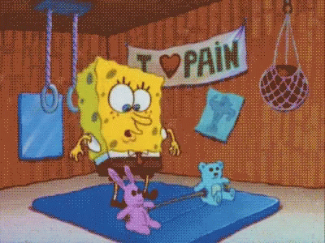

G&G Fitness Equipment. (n.d.). The 21 funniest gym quotes of all time. https://livefit.com/blogs/livefit/the-21-funniest-gym-quotes-of-all-time
The Funny Beaver. (2021, April 6). 50 inspirational fitness quotes because you love yourself. https://thefunnybeaver.com/50-inspirational-fitness-quotes-help-goals/
The Funny Beaver. (2021, April 6). 50 inspirational fitness quotes because you love yourself. https://thefunnybeaver.com/50-inspirational-fitness-quotes-help-goals/
G, L. (2020, June 8). 50 best fitness and workout quotes to get motivated today. Lauren Gleisberg. https://laurengleisberg.com/50-best-fitness-workout-quotes/
cheeso. (2022, May 11). theres no difference between exercise and black magic both of them hurt your body at first and drain you of… tumblr. https://jay-hershelle.tumblr.com/post/684017903260106752/cheeso-theres-no-difference-between-exercise
Johnson, E. (2023, October 31). Finding inspiration and motivation: Gym quotes that Ignite Your Fitness journey. Yanre Fitness. https://www.yanrefitness.com/funny-workout-quote/
Johnson, E. (2023, October 31). Finding inspiration and motivation: Gym quotes that Ignite Your Fitness journey. Yanre Fitness. https://www.yanrefitness.com/funny-workout-quote/
Sazhin, D. (2014). Working out this animation. Dribbble. https://dribbble.com/shots/1624898-Working-out-this-animation
NobleDame. (2018, December 17). Work out excercise GIF - work out excercise spongebob - discover & share gifs. Tenor. https://tenor.com/view/work-out-excercise-spongebob-crossfit-zumba-gif-13093532
Minhcloud. (2018, April 17). Cat exercise GIF - cat exercise dumbbells - discover & share gifs. Tenor. https://tenor.com/view/cat-exercise-dumbbells-workout-sweating-gif-11655168
Feiereisen, S. (2023). 37 motivational exercise quotes to get you through (or to) your next workout. Real Simple. https://www.realsimple.com/health/fitness-exercise/exercise-quotes
Kuehn, K. (2023, February 7). 50 long riddles to give your brain a workout. Reader’s Digest. https://www.rd.com/article/long-riddles/

Slide 2


Physical Activity and Mental Health
Christine MacKay
(M.Ed. Counselling Psychology)
Supervisor: Dr. Danny Balderson
Committee Member: Dr. Elaine Greidanus

Slide 3

About me!
M.Ed. In Counselling Psychology student
Competitive athlete (gymnastics and curling)
Personal and research-based experiences
Passionate about the mind-body connection
Notes:
So everyone already knows that I’m an MEd counselling student. I chose to do a project on physical activity and mental health is few a couple reasons. I have experiences as a competitive athlete in gymnastics and curling, and later in university and my previous job learning more about the mind-body connection. The reason I am so passionate about the mind-body connection comes from

Slide 4
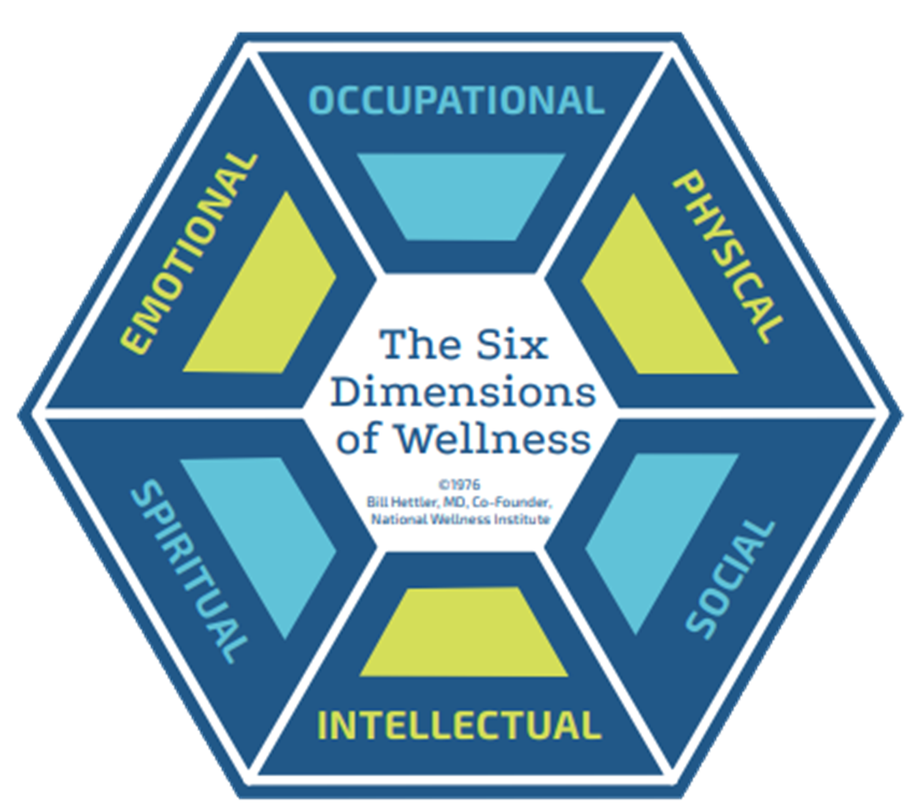
Occupational – career satisfaction
Emotional – optimism
Physical –
healthy lifestyle
Spiritual –
meaning and purpose
Social – relationships
Intellectual – lifelong learning
Hettler, B. (1976). The six dimensions of wellness model. National Wellness Institute. https://cdn.ymaws.com/members.nationalwellness.org/resource/resmgr/pdfs/sixdimensionsfactsheet.pdf
Notes:
So where does physical activity fit within wellness? I studied Hettler’s (1976) model of wellness. He said that you can define wellness through these 6 dimensions. These dimensions are interconnected but specifically defined.
The first dimension of wellness is occupational. So that is being satisfied with your job.
The second dimension is emotional wellness, meaning to be optimistic, and comfortable with feeling emotions.
Then there's spiritual wellness so like finding meaning and purpose in life.
The fourth dimension is intellectual. And that is related to life-long learning
Then there’s social with refers to any relationship and positive connections with others and the environment
Finally we have physical wellness. And that is maintaining a healthy lifestyle through sleep hygiene, nutrition, physical activity, etc. Physical activity will be the focus of this presentation.
As I said earlier these dimensions are interconnected. So for our cohort, I believe we satisfy the intellectual dimension since we almost have 2 degrees at this point. Because of our education, we satisfy the occupational wellness dimension because I hope we love what we’re doing at this point. And then we’ve created amazing relationships within our cohort and with profs and our supervisors and clients, etc. And then by learning about emotions and doing our own therapy we can satisfy the emotional domain and be comfortable with our emotions. Along with being satisfied in our career, I’m sure most of us have found meaning and purpose within our practicums or even in other similar lines of work. And finally, taking care of ourselves is within our code of ethics.
Then in this presentation we’ll see how being physical active can have so many benefits. IN relation to the dimensions, being active you can meet more friends at gyms or by joining a club. Maybe those friends can teach you a new technique or how to use a certain piece of fitness equipment which helps the intellectual domain and etc.
The list goes on and I’m sure you can see how one positive change in one wellness dimensions can have numerous positive benefits in other dimensions

Slide 5
What is Physical Activity?
Sports
Yoga
Cardiovascular exercises
Weight-training
Hiking
Seasonal activities
Notes:
Physical activity comes in many forms. These are just a few I’ve selected but please look at the handout provided for more ideas. Most of these categories are things I enjoy doing. So you know I’ve been comepttive in gymnastics and curling. But I also played things like badminton or track and field for grade school extracurriculars growing up. I absolutely love hot yoga and can’t wait to get a membership. Many of you know I frequented the fitness centre at uleth last year and I primarily did weight training. It was my first time trying out free weights and machines and making my own workouts. It took a lot fo work but it was such a fun challenge! Now unlike in Manitoba, let alone Winnipeg, Lethbridge and its surrounding areas has so many hiking trails and nature walks! I certainly miss those!! And seasonal activities is pretty broad, when I was in Lethbridge there wasn’t much snow and I’m not sure if that’s normal. But there are indoor activities like skating/hockey and mountains close by for skiing. And of course hiking when the weather is nice. And for cardio exercises those really aren’t my favorite. These can be running, swimming, etc. I would prefer to do jumping activities or HIIT exercises before I run on a treadmill. We don’t have to be super well-rounded Olympic level athletes to participate in any of these activities. We’ll see later on how just moving your body can have so many positive benefits. So I would encourage you to find what you enjoy. At the end of this presentation there will be some tips for how to move your body more and engage in being active.

Slide 6
Sedentary Behaviour
Increase in sitting time
Lack of knowledge and/or time for physical activity
Social anxiety
COVID-19
Notes:
Unfortunately, we have our greatest enemy to physical activity. Sedentary behaviour!! Sedentary behaviour has been increasing and it doesn’t help that sitting time and reliance on sitting has been increasing. For university students we’re in class, we’re studying at home with our laptops, and relaxing with our phones and TVs. Research shows that we sit up to 9 hours a day. This was based on self-report and accelerometer-measured sedentary time. I think that sedentary time is actually much higher. We know in psychology that being monitored changes our behaviour. With informed consent and being recorded, I bet the participants were influenced to be more active than usual. In a stereotypical day we’d have maybe 15 minutes to sit down and eat breakfast, half hour to work, 8 hour work day, half our home, 15 mins eating is already at 9 hours. Not to mention leisure time. But I digress, data is data but I know I sit more than 9 hours a day easy.
Another factor for sedentary behaviour is not knowing what to do or how to do it. This is also related to that anxiety about exercising in front of others at the gym or not knowing how to use certain equipment. Fredrikkson and colleagues from a 2018 study found that the majority of adults don’t know what the physical activity guidelines are. Only those who were more knowledgeable of guidelines were already more active. Do you know what the Canadian guidelines are? 2.5 hours per week (moderate and vigorous aerobic and strength-training)
And of course as university students we’re so busy!! These last 2 years for me have been tough juggling time. Last year I did fairly well at maintaining my activity levels but lately it’s been more difficult. We have so many assignments and hours and class time that I agree finding the time is so difficult. But hopefully as we near the end of our programs that we will have more time to take care of ourselves.
And finally we know that COVID-19 was super disruptive to being physically active. For some specific data, step counts decreased by 25% from 2019 to 2022 and still remain lower than their 2019 numbers.
Sedentary time has negative effects on our physical and mental health. Being less active means lowered mood, higher chance of mental health concerns, and not to mention the other physical consequences such as cardiovascular disease.

Slide 7
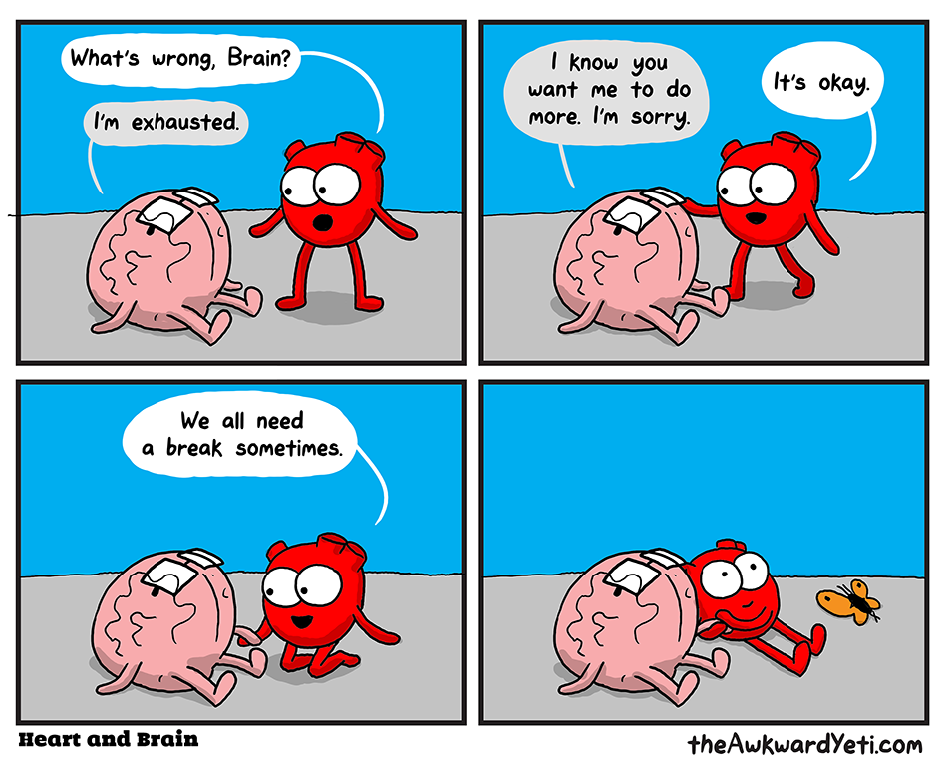
Notes:
So I know that hammering home that sedentary time is not good for us and we should be more active. But I also want to emphasize that taking breaks is OKAY. I know our cohort is so Type A and has perfectionist qualities and the “get it done mindset”. But if we’re legitimately tired from either physical activity or stress, sometimes we do need a rest day. Listen to your body and your needs to take care of yourself

Slide 8
Benefits of Physical Activity
Notes:
So now that we’re done talking about all the negative, let’s learn about some of the benefits that physical activity has on our wellbeing

Slide 9
Higher GPAs
University students with or without a fitness centre membership
0.13 GPA points higher than students without a gym membership
Difference between a graduate program, scholarship, or passing a course
Physical Activity
BDNF Release
More brain cells!
Notes:
For one, some research shows that having a gym membership and participating in physical activity gives higher GPAs. Now this difference of 0.13 GPA points may seem like a very small difference, but it could mean getting into further education. As we know our program is so highly competitive and that GPA difference might mean the waitlist or getting an interview. Also important for receiving scholarships or even passing a course.
So how does this happen? Well when we exercise our bodies release lots of great chemicals, hormones, neurotransmitters, etc. One that I want to focus on is BDNF which is brain derived neurotrophic factor. This is responsible for brain and neuronal growth. With exercise much of this growth occurs in the hippocampus. The hippocampus is mainly responsible for our memory. So with physical activity, we release a lot of BDNF in the hippocampus and the hippocampus grows in density and its connections. So our memory improves and thus our GPAs would likely improve as well.

Slide 10
Higher happiness and overall health
Ireland
Students meeting physical activity guidelines vs. not meeting guidelines
Active students had better overall health, mental health, and happiness
Madrid
Students and levels of physical activity (low, medium, high) and location (occupational, commuting, leisure)
More physical activity = better mental health
More physical activity during leisure and occupation are protective to poor mental health
Notes:
Another benefit to physical activity is higher happiness and overall health. I looked at 2 studies, one from Ireland and one from madrid.
In the Ireland study, makes sense
In Madrid they specified types of activity and where students are being active (at work, commuting and leisure). So obvs more physical activity means better health outcomes. But specifically more physical activity during leisure and work times were found to the best protector of mental health outcomes

Slide 11
Mental Health
Depression
Depressed mood, decreases in pleasure,…,diminished self-esteem and cognition, etc.
Anxiety
Restlessness, muscle tension, sleep disturbances, and difficulty controlling worrying thoughts

Slide 12
Physical Activity on Mental Health
Depression
Physical activity condition reported lower BDI scores than no treatment condition
Alleviates depressive states
Anxiety
High intensity, aerobic (cardio) physical activity seems most effective to relieve anxiety symptoms
Notes:
Number of symptoms on BDI reduced in a physical activity condition.
Alleviates depressive states in females with mild depression
I know it’s hard when we’re feeling slumpy that moving your body seems to be the worst thing ever but just go for a walk or do some floor yoga
Meta analysis for anxiety. Aerobic reduced anxiety more in patients with clinically raised anxiety compared to waitlist controls. And high intensity more effective than low intensity

Slide 13
How Does Physical Activity Influence Mental Health?
Physical Activity
Neurotransmitters
BDNF
Stress response system
Decrease in anxiety and depressive symptoms
Neurotransmitters
BDNF
Stress response system
Notes:
So what is the biological connection between physical activity and mental health outcomes? I studied the HPA axis (hypothalamic-adrenal-pituitary axis). If you’d like to read more about it in my paper I’ll provide the final copy when it’s done.
So the HPA axis is the body’s stress response system. When exposed to a stressor like being chased by a tiger then it releases cortisol and activates the fight or flight system. Cortisol is the body’s main stress hormone. But stress can also come in mental emotional or social forms. Being in a state of chronic stress (toxic relationship, academics) causes a dysregulation of the HPA axis.
In depression and anxiety there is hyperactivation of the HPA axis which does not help with symptoms. This is measured by cortisol levels throughout the body.
But physical activity acts as a positive stressor on the HPA axis. The HPA axis still releases cortisol but along with all of these other amazing chemicals and hormones and neurotransmitters (serotonin, endogenous opiods (rush), and BDNF. And remember BNDF is responsible for brain growth. So all of these happy chemicals strengthen the brain against stress and regulate the HPA axis in individuals with anxiety and depression and even neurotypical people. So chronic exercise increases tolerance to future stress which may help with our careers, busy schedules, relationships, etc.

Slide 14
How to Become More Active
Learn more about the benefits of physical activity
Have a 2-minute solo dance party to your favourite song
Join a club or team
Get a walking/active buddy

Slide 15

Thank you!
Questions?

