Slide 1
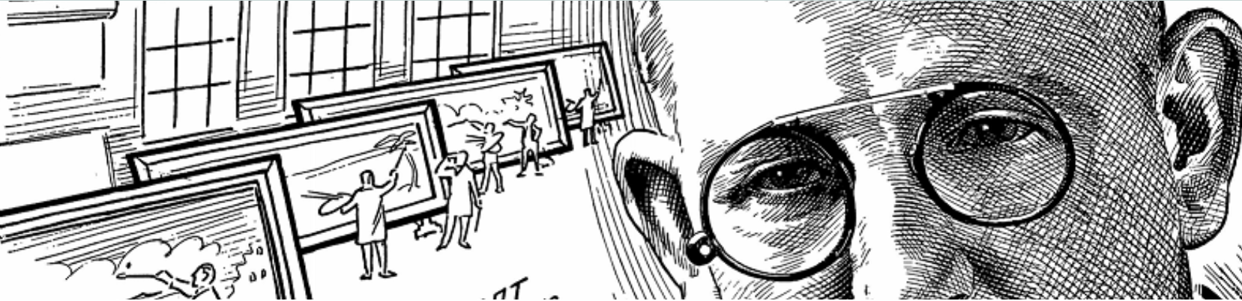
Gibson Catlett (1866-1935)
"They say that 'Art is long and time is fleeting,' but your great scenic grandeur seems sufficient to make artists of us all." -- Gibson Catlett, 1910.
Painter of Topographical Bird’s-Eye Views for Real Estate Advertisements
Notes:
Today I’ll be talking about ONE of the projects I undertook while on my six-month study leave… which relates to bird’s eye view topographical paintings that were used to sell real estate in the early 1900s. In particular, I’ll focus on one such artist – an individual named Gibson Catlett – who I found particularly interesting and who has – until now –been virtually unknown…

Slide 2
Part I
The Story of a Painting: Bird’s-Eye View of City of Lethbridge, 1912
Notes:
Let’s begin with how I became interested in this topic in the first place…

Slide 3
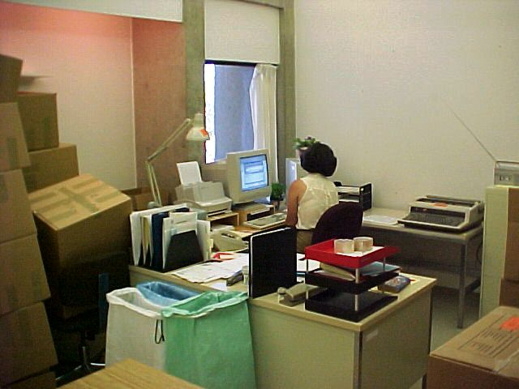

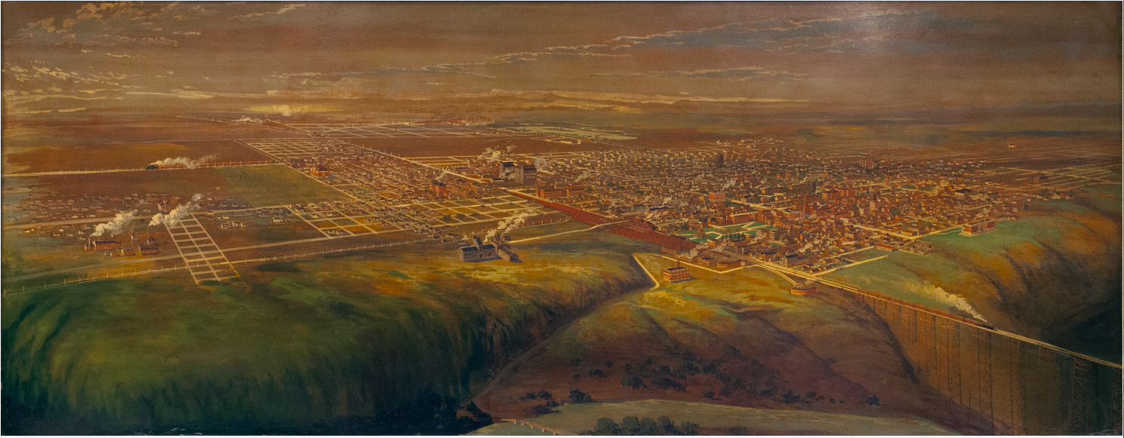
University of Lethbridge Archives (ca. 2001)
Notes:
It was back in April of 2001 when I arrived at the University Library… then located in University Hall. For a few months my desk was in the University Archives not far from where Doris Kostiuk is sitting in this photo. On the opposite wall from Doris [CLICK] was an immense painting of Lethbridge (about eight feet wide and four feet tall)… which appeared quite old and showed a very different city from today’s. I found it fascinating and looked at it closely…

Slide 4
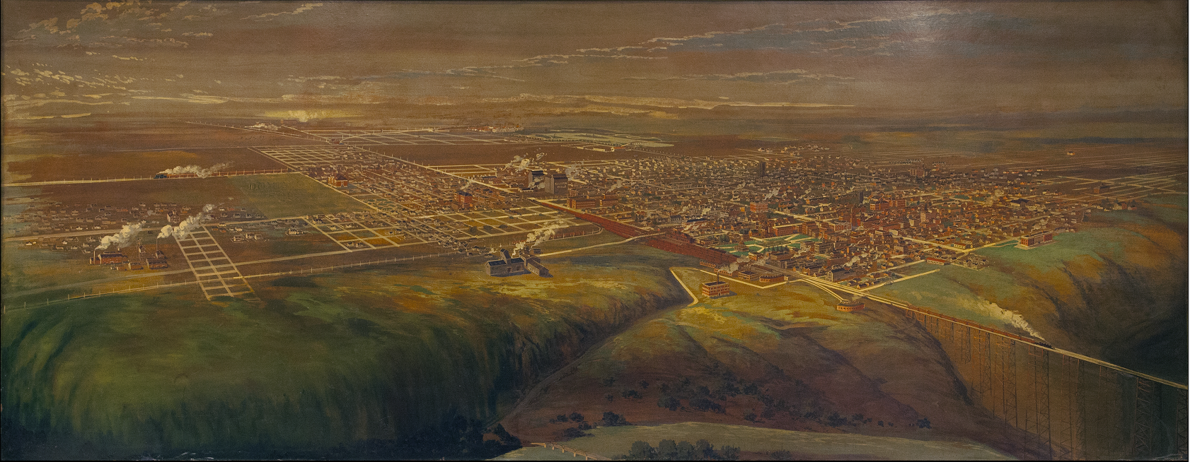
Bird’s-Eye View of City of Lethbridge, 1912
1st Ave. S.
13th St. S.
13th St. N.
6th Ave. S.
North
Notes:
Here’s a photo of it…. a bird’s eye view of Lethbridge in year 1912 from an imaginary point several hundred feet above what is now the Crowsnest highway…. It’s looking southeast towards the downtown.
Let’s orient ourselves… [CLICK]… [CLICK] Can anyone identify this road? [CLICK] It’s 1st Ave…. the railroad tracks demarcate North and South Lethbridge… [CLICK] this one? [CLICK] This is 6th Ave. South which turns into Whoop-Up Drive [CLICK] This one? [CLICK] 13th Street which is today one of the city’s main North-South arteries.

Slide 5
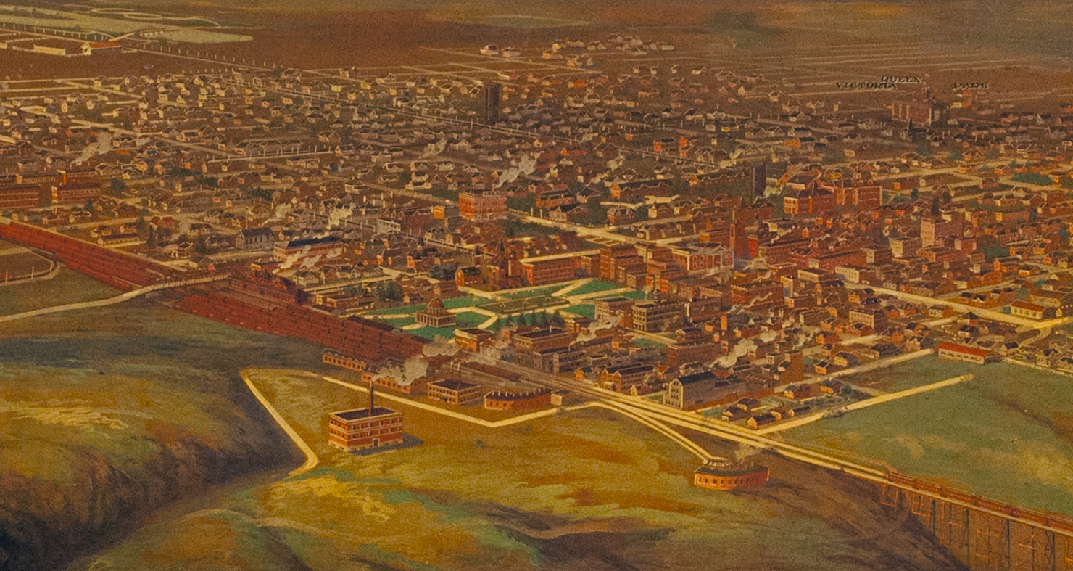
1
2
13th St. S.
6th Ave. S.
1st Ave. S.
4
3
5
6
Notes:
Looking closer at downtown… Let’s see if anyone is able to recognize these features:
1. Henderson Lake… note the Electric railway power lines.
2. This is a water tower… known as “standpipes” in the day; it’s at 14th Street & 6th Ave. South… there’s another one at 9th Street & 5th Ave. South.
3. The Canadian Pacific Railway Station… still at the same location but now occupied by the Lethbridge Health Unit.
4. Galt Gardens… note the pavilion which was operated by the City’s Board of Trade... Its no longer there.
5. The Woolen Mill… it was fairly new in 1912 but turned out to be a short-lived industry.
6. Macleod Road – This is one of the ways you could leave the city… it would take you down to the river valley to a bridge across the river… about where the Crowsnest Highway #3 crossing is today.

Slide 6
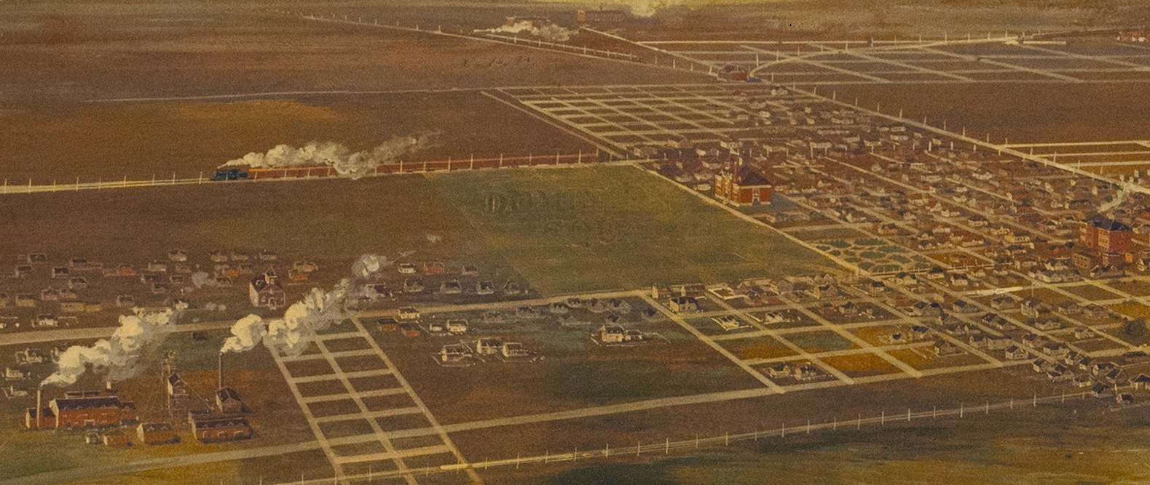
9th Ave. N.
13th St. N.
Notes:
This is North Lethbridge… inside the yellow oval you can see Galbraith Elementary School along 9th Avenue North… which is still there today… just to the left of it is faint lettering that says “DOMINION SQUARE.” This was one of the features of the painting that was baffling to me when I first noticed it…

Slide 7
Where is this painting now?
Notes:
Fast forward to 2018… Mike Perry was on leave and my Library duties included answering Archives reference questions… during that time I stumbled upon a photograph of the bird’s-eye view painting that I’d seen years ago in the old Archives… vacated when this, the “new” Library opened in August, 2001.
So where is the painting now?

Slide 8
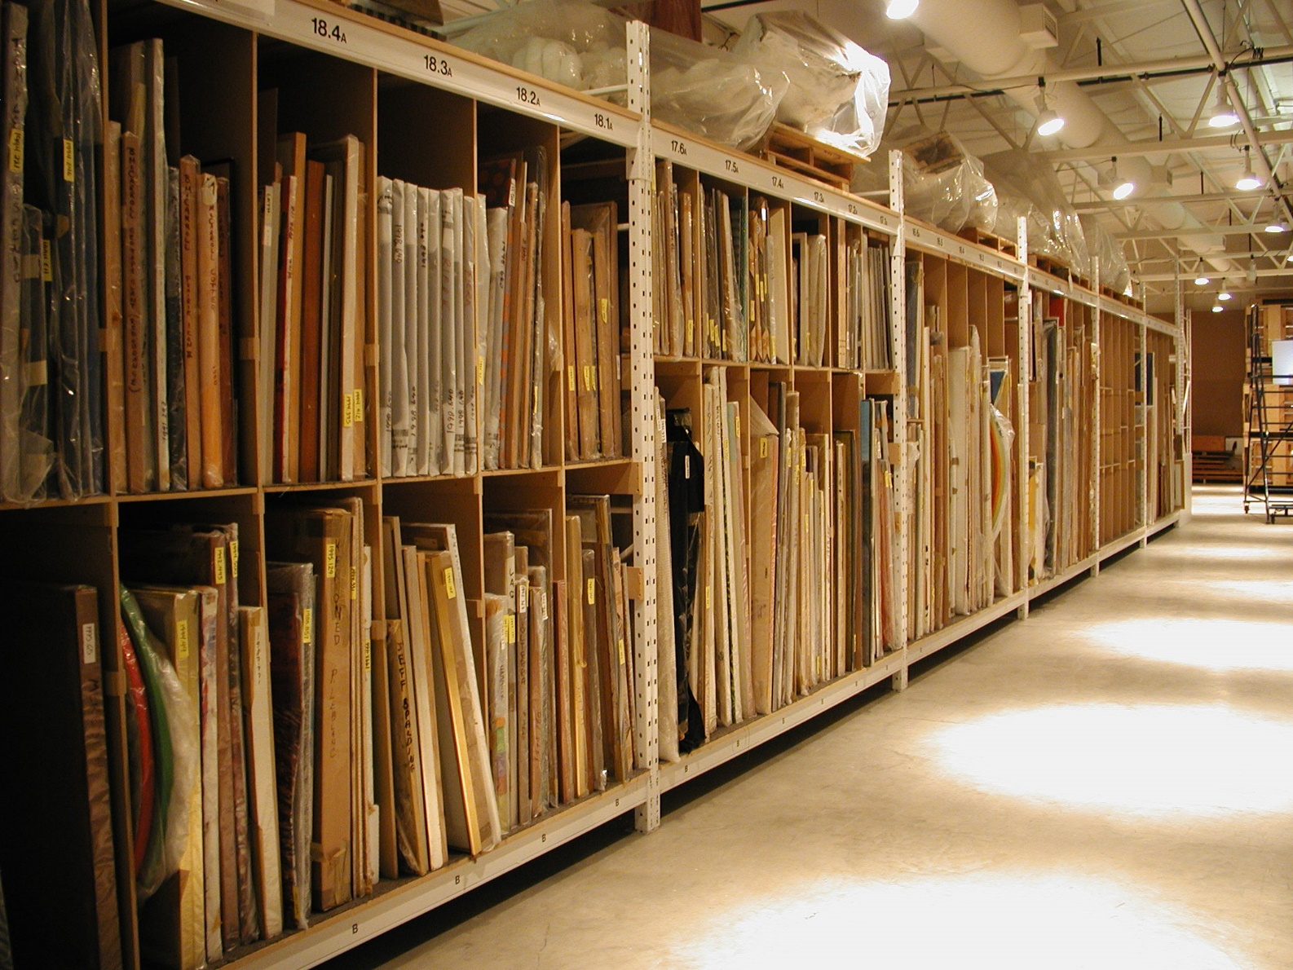
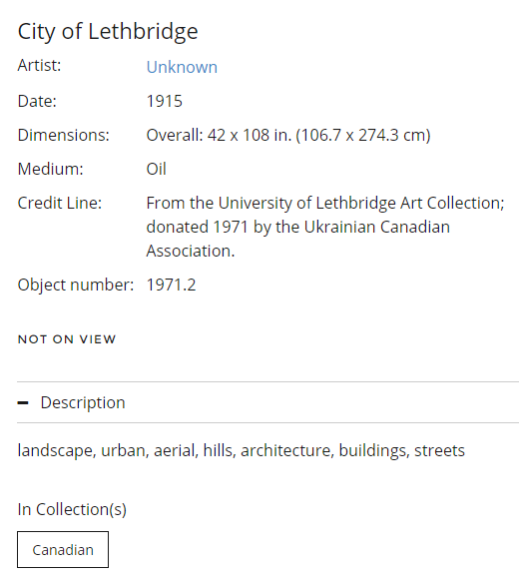
The University of Lethbridge Art Collection
https://artgallery.uleth.ca/u-of-l-art-collection/
Notes:
The answer is that it’s in the University’s Art Collection… this is the record for it in their art database. The photo on the left shows how paintings are stored when not on display.

Slide 9
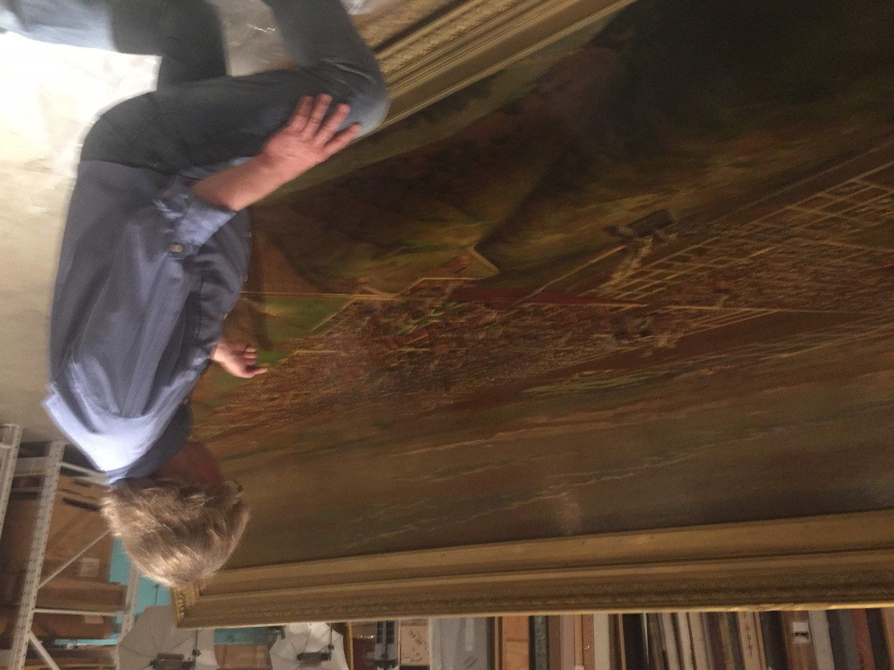
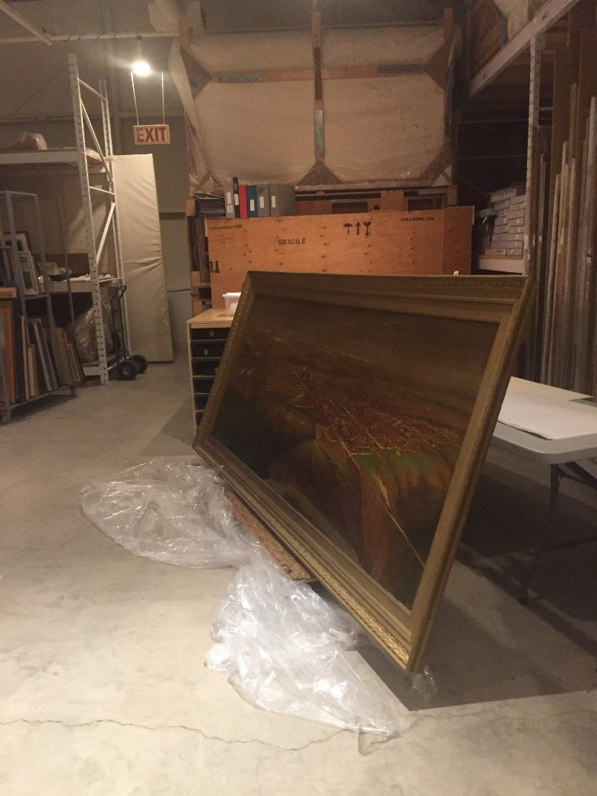
University of Lethbridge Art Vault (2018)
Notes:
So I contacted Jon Oxley, Art Gallery manager, and arranged to have him take a high resolution photo of the painting… this is Jon on the day they were photographing it and other paintings.

Slide 10
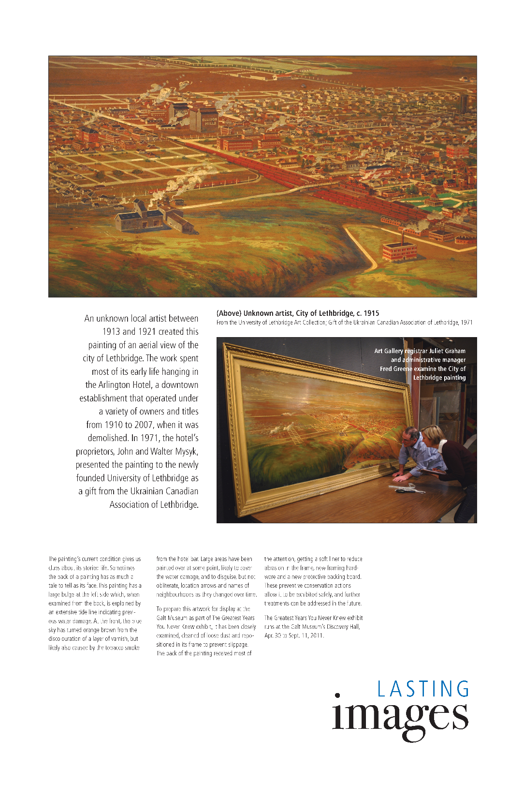
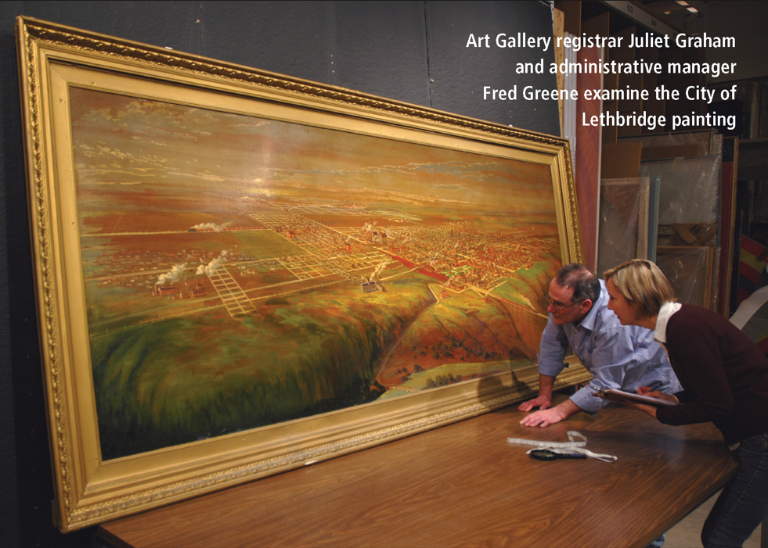
The Legend (2011, April)
https://issuu.com/ulethbridge/docs/thelegend_1010_april_2011/7
Notes:
The painting has been on display a few times in the past… most recently at the Galt Museum in 2011 for their “Greatest Years” exhibit. An article in the Legend campus newspaper at that time provided details about its condition…

Slide 11
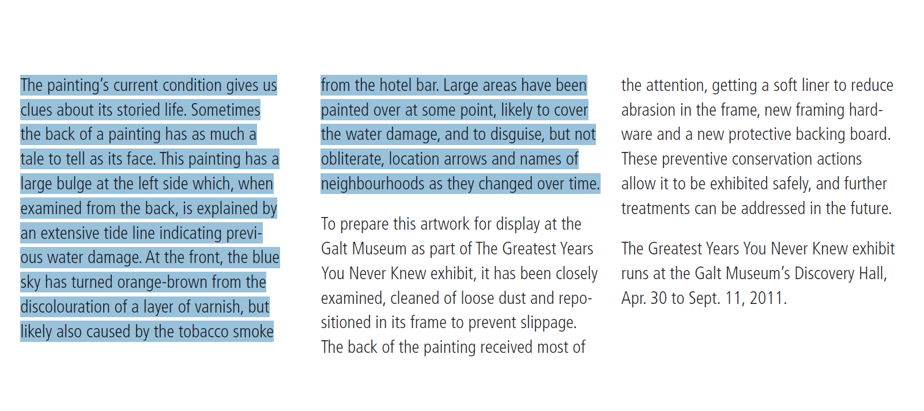
Notes:
“[it’s condition] gives us clues about its storied life. The painting has a large bulge at the left side which, when examined from the back, is explained by an extensive tide line indicating previous water damage. At the front, the blue sky has turned orange-brown from the discolouration of a layer of varnish, but likely also caused by the tobacco smoke from the hotel bar. Large areas have been painted over at some point, likely to cover the water damage, and to disguise, but not obliterate, location arrows and names of neighbourhoods…“

Slide 12
How did this painting end up at the U. of Lethbridge?
Notes:
I also wanted to find out a little more about this paintings “life“ before ending up at the University…

Slide 13
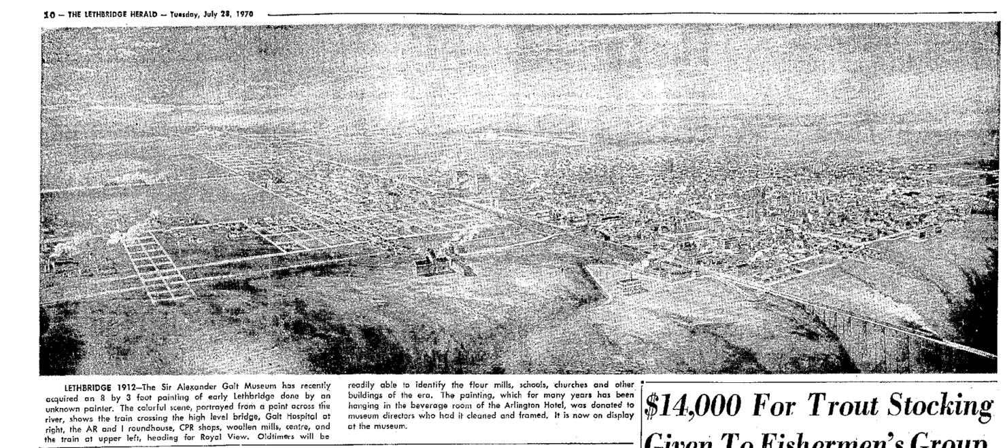
Galt Museum Acquires Painting (1970)
Notes:
Using the NewspaperArchive database, I came across articles detailing what was known about it’s history. It was acquired by the Galt Museum in 1970 after hanging for many years in the smoky “beverage room” of the Arlington Hotel.

Slide 14
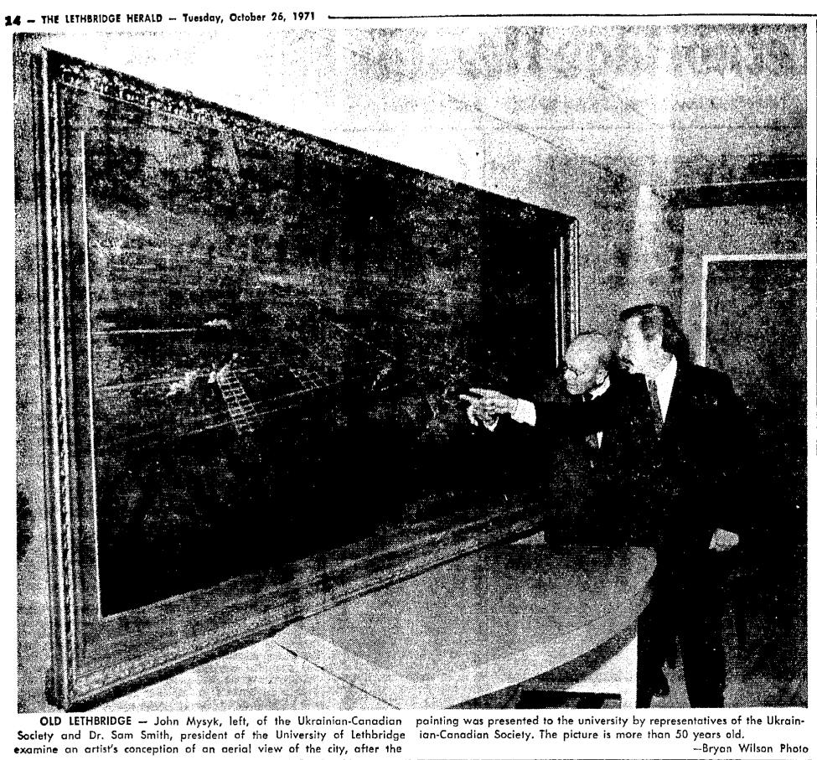
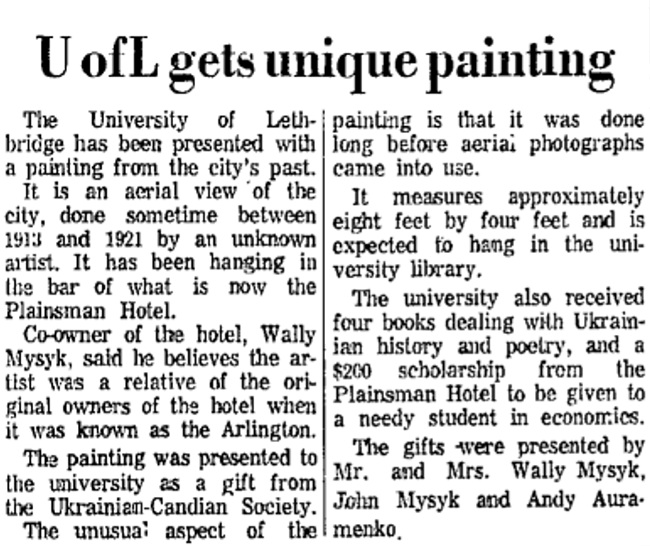
Donation to U. of Lethbridge, Lethbridge Herald (1971)
Notes:
A year later, in 1971, it left the Galt for reasons unknown, and was donated to the U. of L. by Wally Mysyk, owner of the Plainsman Hotel… formerly known as the Arlington Hotel.
Interestingly, when it was donated, it was “expected to hang in the university library.”

Slide 15
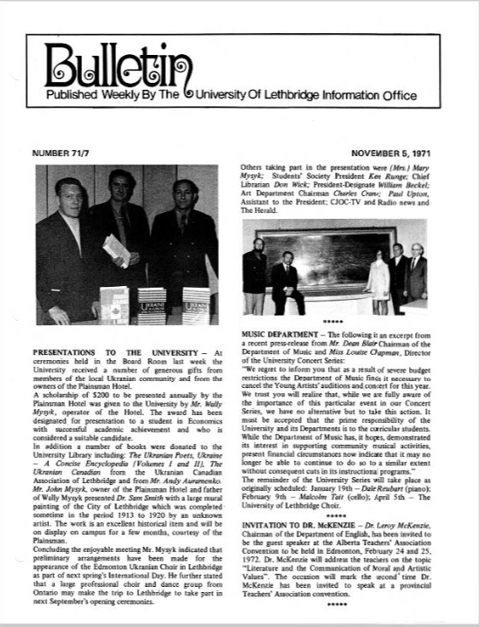
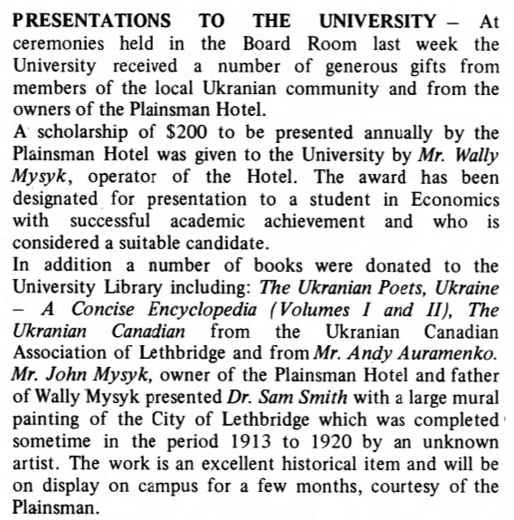
Donation to U. of Lethbridge, Bulletin (1971)
https://digitallibrary.uleth.ca/digital/collection/publications/id/1920/rec/1
Notes:
Here’s some similar information about the donation as reported in the campus newspaper of the day… “The Bulletin” which I found in our very own Digitized Collections.

Slide 16
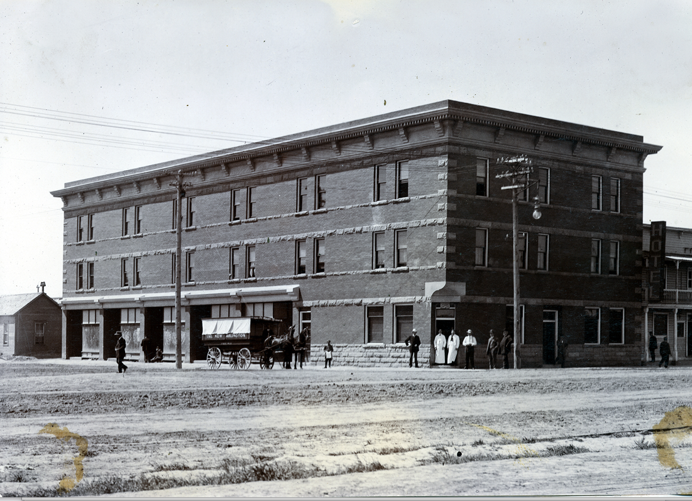
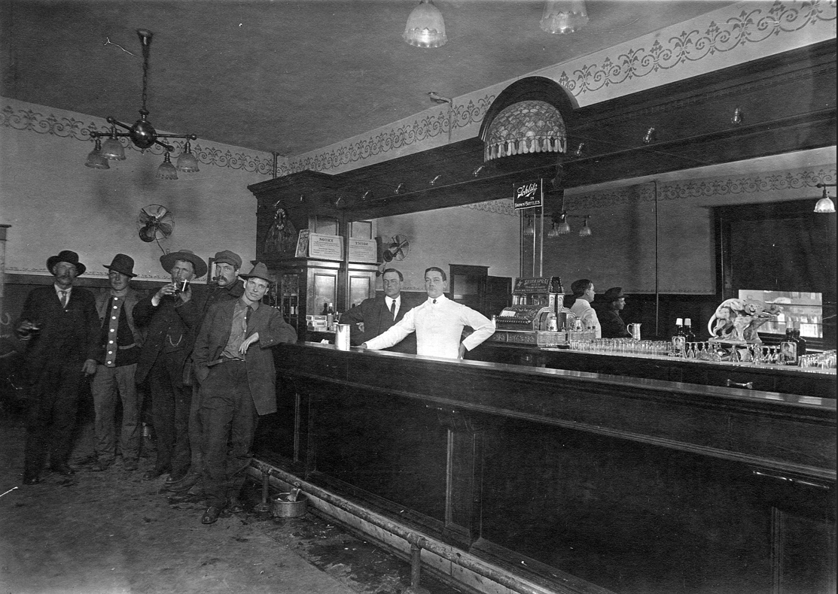
Arlington (renamed Plainsman) Hotel, 1st Ave. & 3rd St. South
c.1912
1900
Galt Archives P19891049184
Galt Archives P19760211018
Notes:
On the left is a photo of the Arlington Hotel from year 1912… note the unpaved streets. On the right is what I assume is the “Beveridge Room” of the hotel.

Slide 17
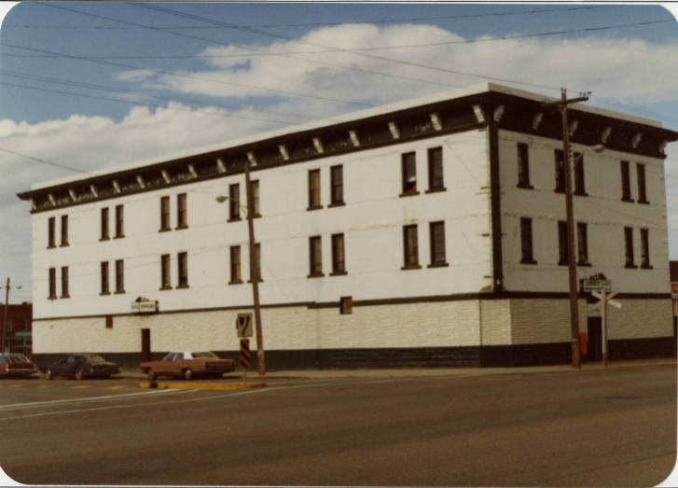
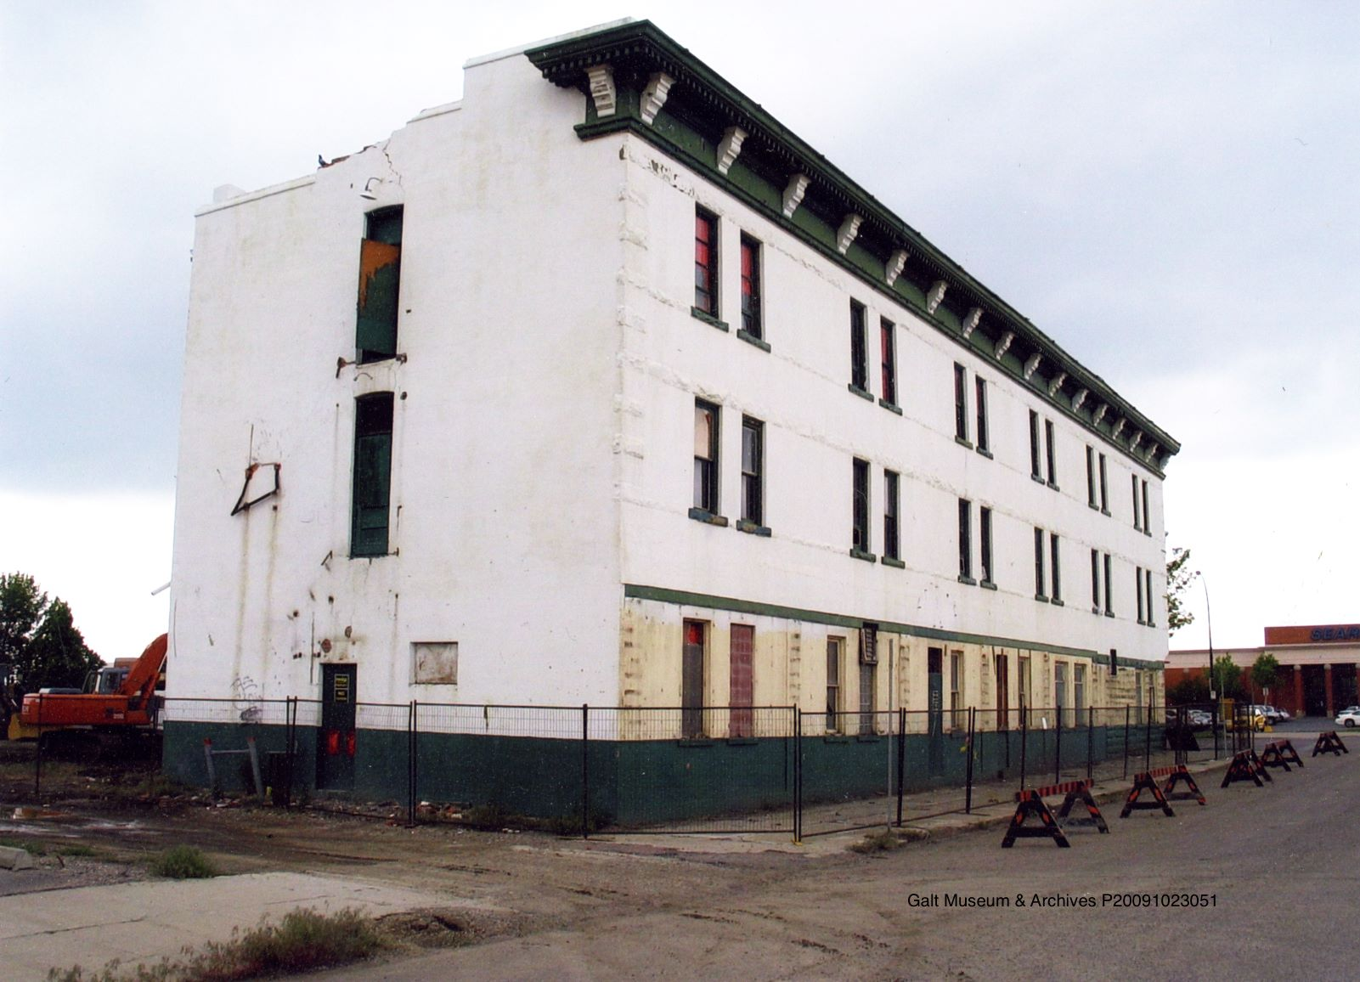
Bridge Inn Hotel (Formerly Plainsman), 1st Ave. & 3rd St. South
1980
2007
https://digitallibrary.uleth.ca/digital/collection/cityphotos/id/422/
Galt Archives P20091023051
Notes:
Some of you may have known the hotel when it was the Bridge Inn… there was photo taken in 1980 in our Digitized Collections… and the Galt Archives also documented its demolition in 2007. It was located directly across the street from the Park Place mall… you can just see the Sears store at the mall peeking out in the background.

Slide 18
Who painted the Bird’s-Eye View of Lethbridge? Why?
Notes:
I became interested in figuring out who actually painted the bird’s eye view of Lethbridge… and why.

Slide 19
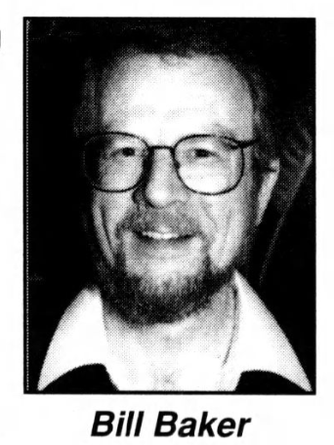
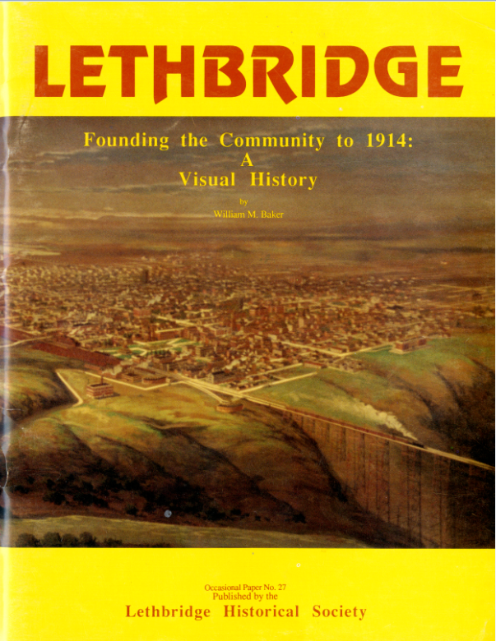
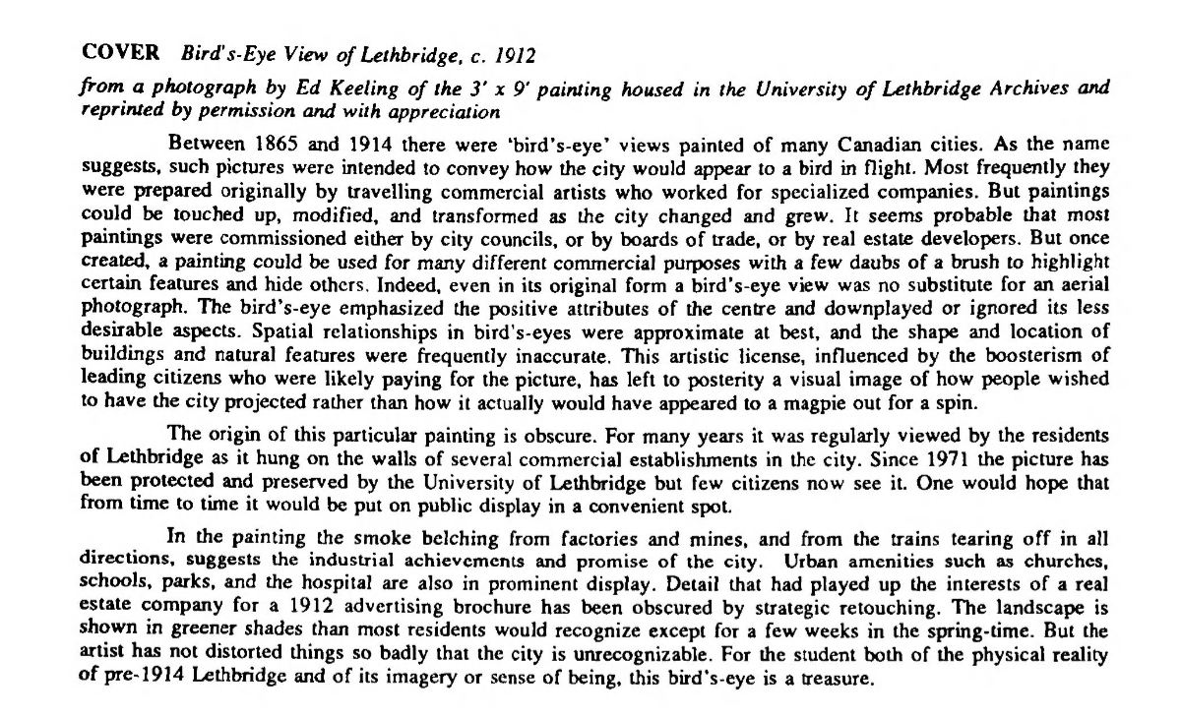
Lethbridge Historical Society (1992)
http://digitallibrary.uleth.ca/cdm/ref/collection/lhs/id/2048
Notes:
In researching the painting, I came across this Lethbridge Historical Society publication by U. of L. History professor Bill Baker.
He wrote that… [CLICK] bird’s eye views were prepared by travelling commercial artists who worked for specialized companies… paintings could be touched up, modified and transformed as the city changed and grew… most paintings were commissioned by city councils, Boards of Trade or real estate developers. Once created, a painting could be used for many difference commercial purposes with a few daubs of a brush to highlight certain features and hide others…
He also provided a clue about its painter when he noted [CLICK]… “Detail that has played up the interests of a real estate company for a 1912 advertising brochure has been obscured by strategic retouching.”

Slide 20
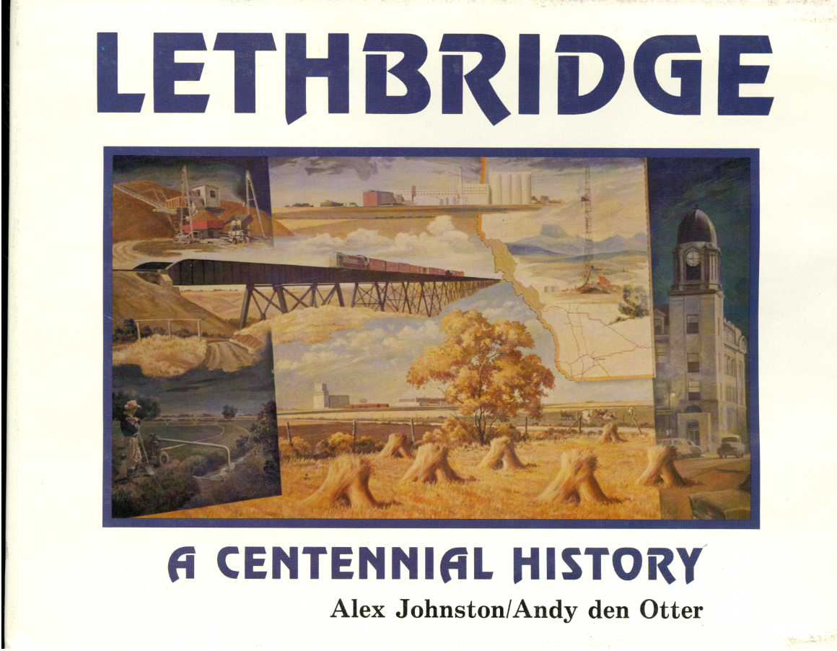
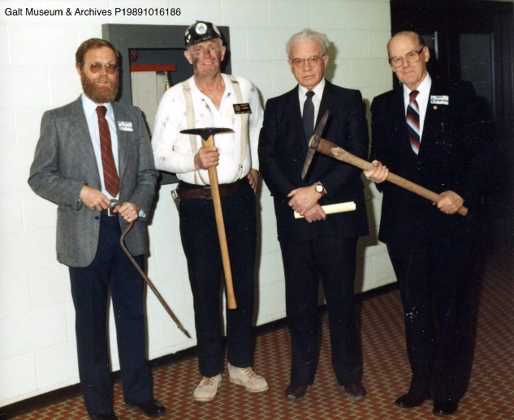
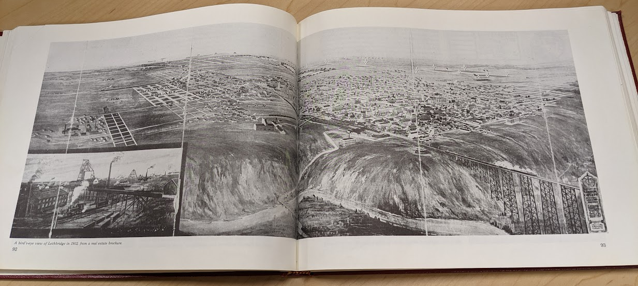
Lethbridge: A Centennial
History (1985)
https://go.exlibris.link/7Mdd3N1y
Notes:
I found that real estate brochure… which had been re-published in the book “Lethbridge A Centennial History” by Alex Johnston… it’s similar to the painting but differs in a few key areas… CAN ANYONE NOTICE A DIFFERENCE?

Slide 21
Notes:
Here’s the original again.

Slide 22
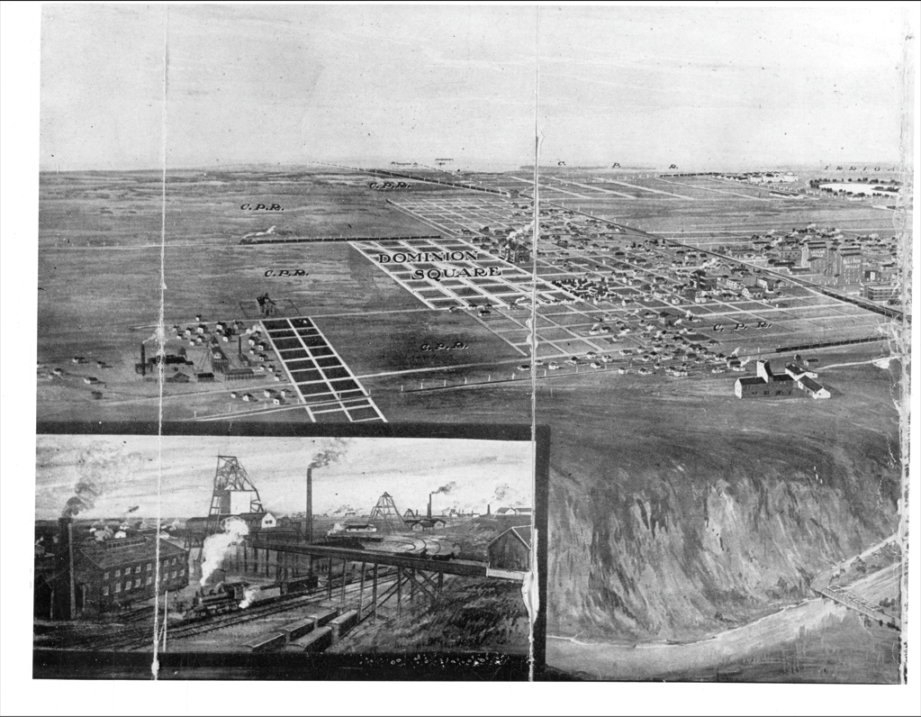
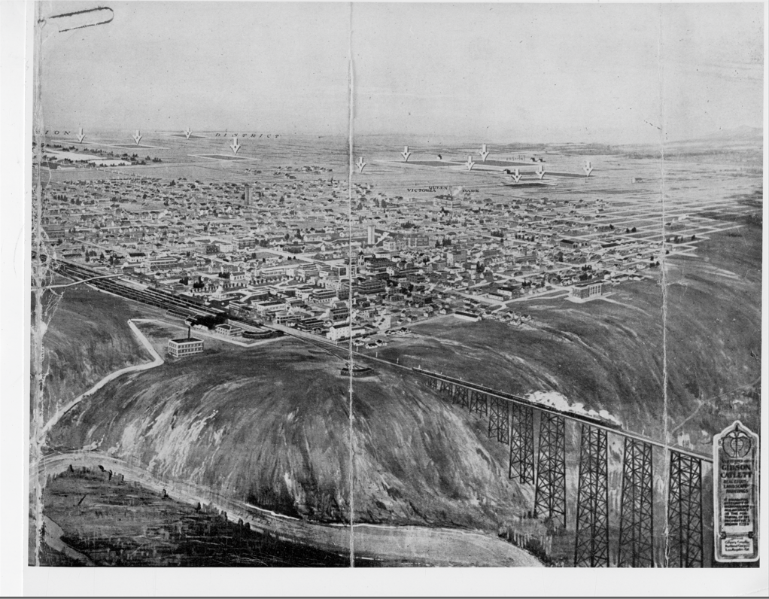
Real Estate Brochure (Galt Archives)
Galt Archives 19754374013copy3
Notes:
Andrew Chernevych from the Galt was able to locate a digital copy of the 1912 real estate brochure. You can see sections that are different from the painting…
(1) This area on the northside with the words “DOMINION SQUARE” and a grid of proposed streets… which was painted over
(2) The industrial scene as an inset showing one of the Galt company coal mines…it was removed from the original. Perhaps the water damage to the back of painting noted by the Art Gallery might have occurred during its removal.
(3) Eleven numbered arrows which were pointing out properties for sale… they were painted over.
(4) And, most importantly – also removed from the original – was a label indicating who produced the painting depicted in the brochure...

Slide 23
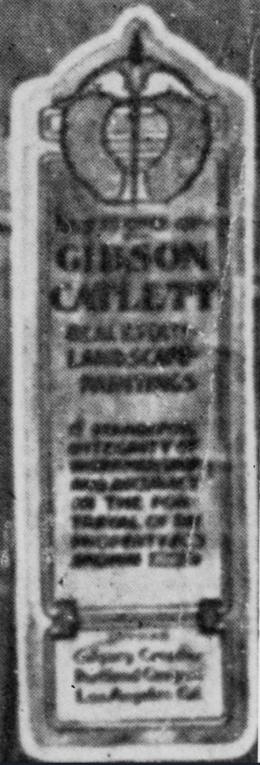
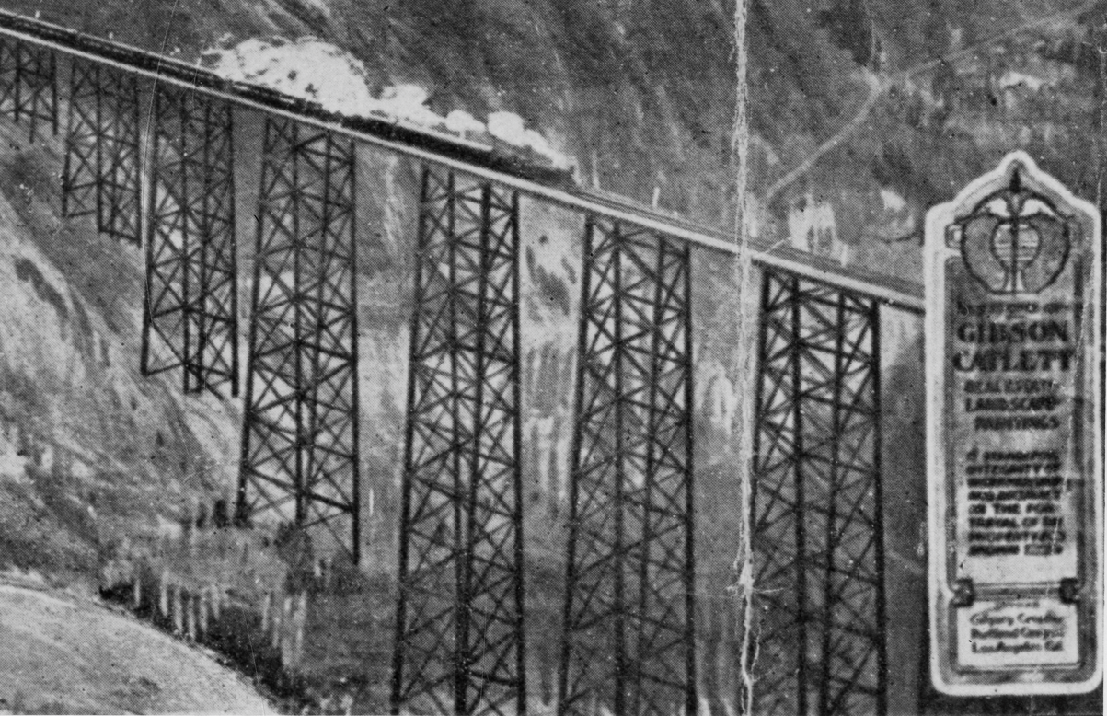
Label on the Real Estate Brochure
Notes:
The most legible part of the label reads “This is one of the Gibson Catlett Real Estate Landscape Paintings…”

Slide 24
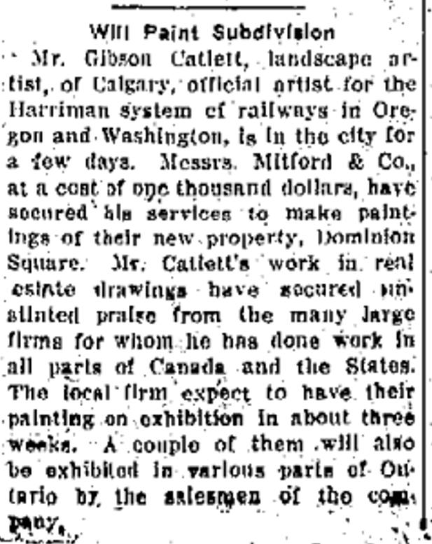
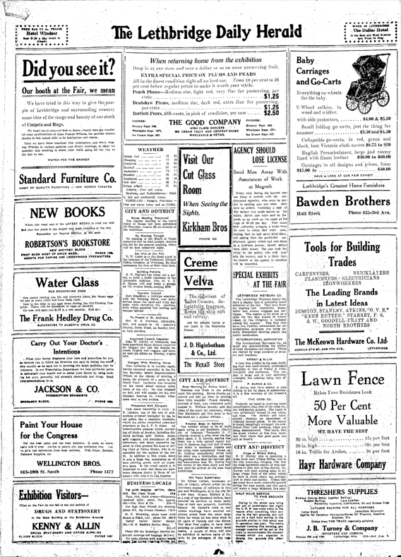
Lethbridge Herald
(1912, August 22)
Notes:
So back to the NewspaperArchive database - a search turned up an article confirming that artist Gibson Catlett of Calgary had been in the city in 1912 to make a $1,000 painting for the real estate developer Mitford & Company. The development being advertised was called “DOMINION SQUARE”… the same name that had been painted over on the bird’s eye view painting.

Slide 25
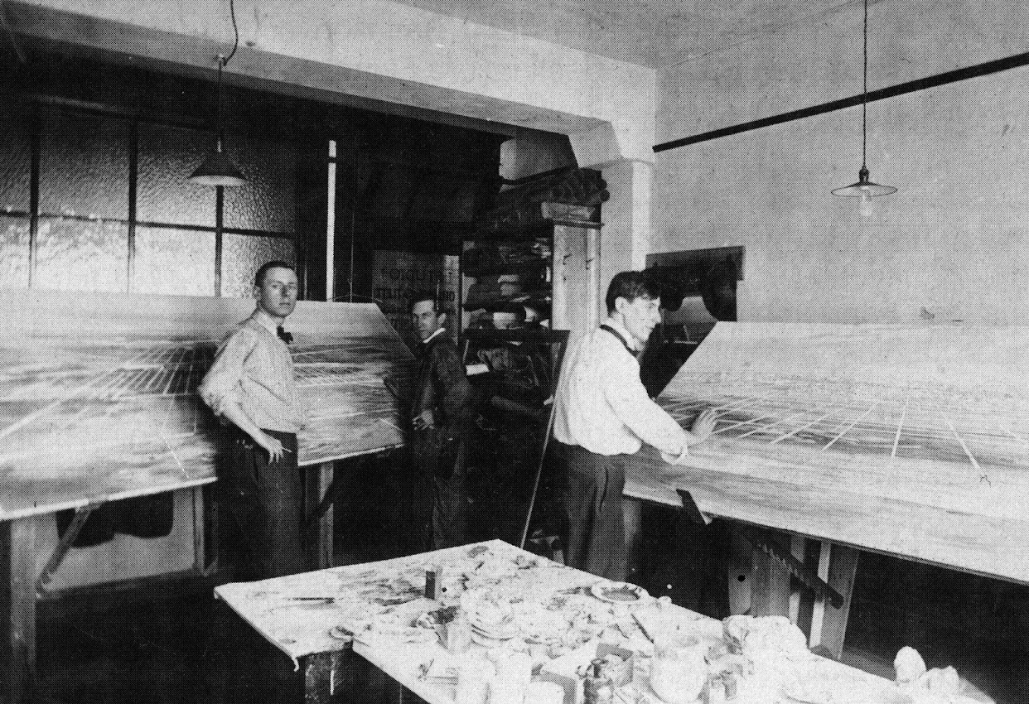
Gibson Catlett Studios, Calgary, Alberta (ca. 1910-1912)
Notes:
Here’s the Calgary studio of Gibson Catlett -- the man standing in the centre of photo – alongside him are artists that he employed to assist in colouring the landscape views for advertising real estate.
Catlett typically did sketches of the site and buildings… and then had his artists put them on canvas and add colour.
The artists are possibly Austin Cooper (left) and Adam Sherriff-Scott (right).

Slide 26
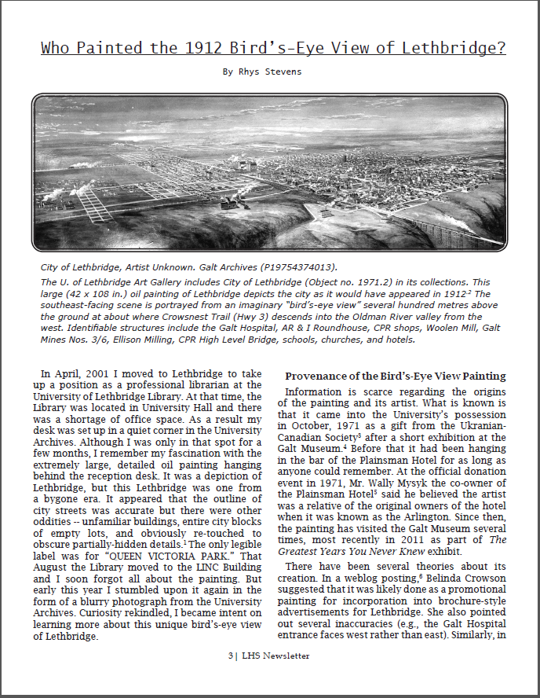
Lethbridge Historical Society Newsletter Article
2018
https://opus.uleth.ca/handle/10133/5121
Notes:
I wrote up much of this in a Lethbridge Historical Society article…

Slide 27
Part II
Bird’s-Eye Views of Alberta
Notes:
In the process of tracking down details about the Lethbridge painting, I came across a lot of other material about bird’s eye views…

Slide 28
What is the significance of a bird’s-eye view?
Notes:
Views themselves can more than just a colourful representation of a bygone era… and can actually be used as a source of scholarship.

Slide 29
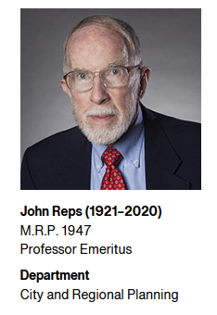
Bird’s-Eye Views – John W. Reps
City street patterns, significant buildings, and topographic features and are often readily identifiable in bird’s-eye views. In some locales, these maps can be the only available option for obtaining such details. It is for these reasons that scholars have “...rediscovered these views as sources for research in the history of architecture, city planning, transportation, urban geography, printing technology, and other fields” (Reps,1984, p. 16).
Reps, J. W. (1984). Views and viewmakers of urban America: Lithographs of towns and cities in the United States and Canada, notes on the artists and publishers, and a union catalog of their work, 1825-1925. Columbia: University of Missouri Press.
https://go.exlibris.link/1LcgnmtZ
Notes:
John Reps – seen here -- was the foremost expert on the history of American urban planning and urban iconography. He literally wrote the book on the history of urban planning with his publication The Making of Urban America… and his other books exploring the origins and growth of towns and cities.
He ALSO wrote books about 19th-century printed views… identifying the artists who created them, and explaining how they were drawn, printed, published, sold, and used.
In the quote above, he indicates that these views can be “…sources for research in the history of architecture, city planning, transportation, urban geography, printing technology, and other fields.”

Slide 30
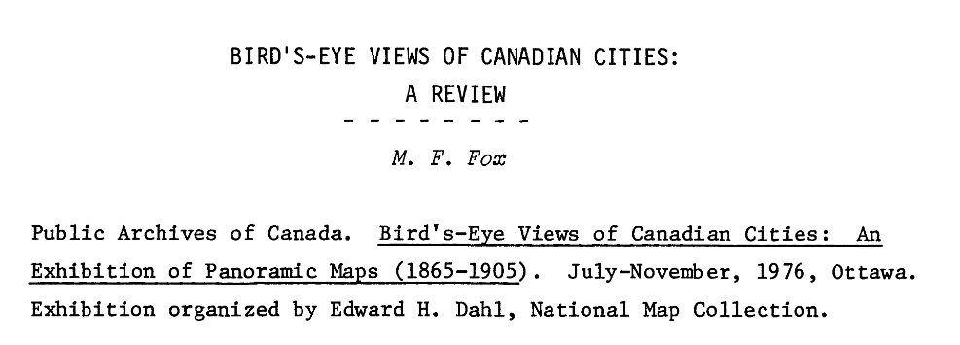
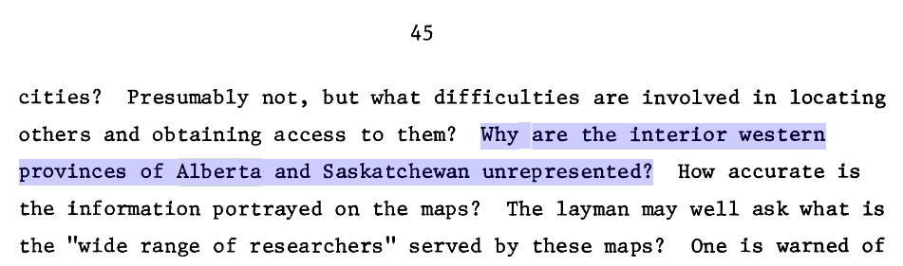
Bird’s-Eye Views of Canadian Cities: An Exhibition of Panoramic Maps (1865-1905)
Fox, M. F. (1977). In Artibise A. F. J., Muise D. A. and Taylor J. H.(Eds.), Bird's-eye views of Canadian cities: A review. Urban History Review / Revue d'histoire urbaine. https://doi.org/10.7202/1019589ar
Notes:
Something else that I came across was a review of an exhibition of bird’s eye views held in 1976 at the Public Archives in Ottawa . The exhibit included 78 bird's-eye maps of 75 Canadian cities… interestingly, the reviewer noted that “…the interior western provinces of Alberta and Saskatchewan were un-represented.”
So I thought I’d see what bird’s-eye views of Alberta I could find myself in library collections, archives, museums, galleries and in newspaper advertisements.

Slide 31
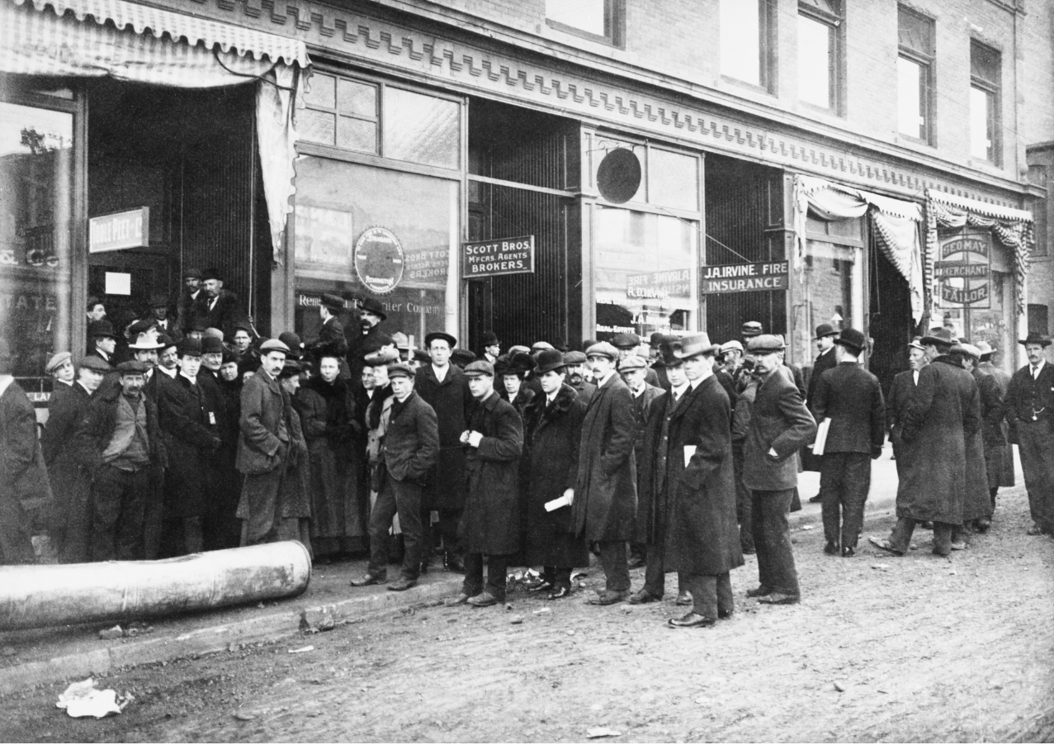
Alberta’s Real Estate Boom
Line-up for land sales, Calgary, Alberta. [ca. 1911-1912]
In front of offices of Toole, Peet and company, 301 - 8th Avenue SW. Real estate agents for Canadian Pacific Railway suburbs.
Digital Identifier CU1107601
Courtesy of Libraries and Cultural Resources Digital Collections, University of Calgary.
Notes:
Many of the bird’s eye views I found were – like the Lethbridge view – advertisements created for real estate developers. A lot were from about 1910 to 1912 which coincided with the peak of a provincial real estate boom as immigrants flooded across the Prairie provinces and into Alberta...

Slide 32
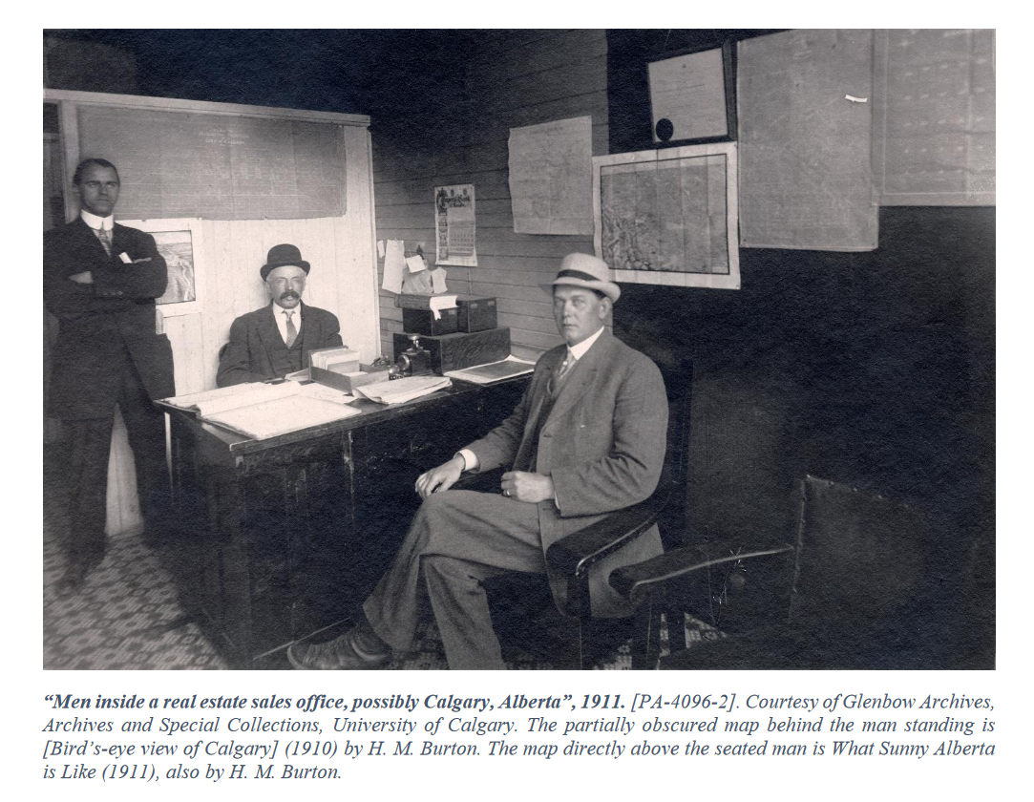
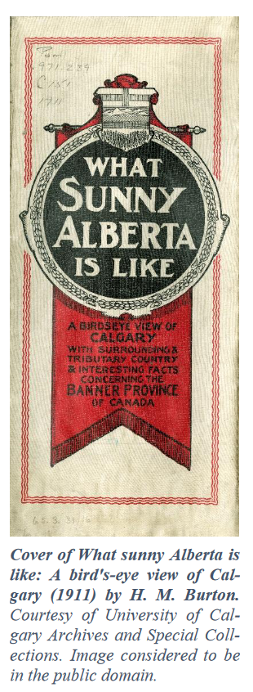
Real Estate Landscape Paintings & Advertisements
Notes:
Here’s the inside of Calgary real estate office in 1911… notice the many maps hanging on the office walls…

Slide 33
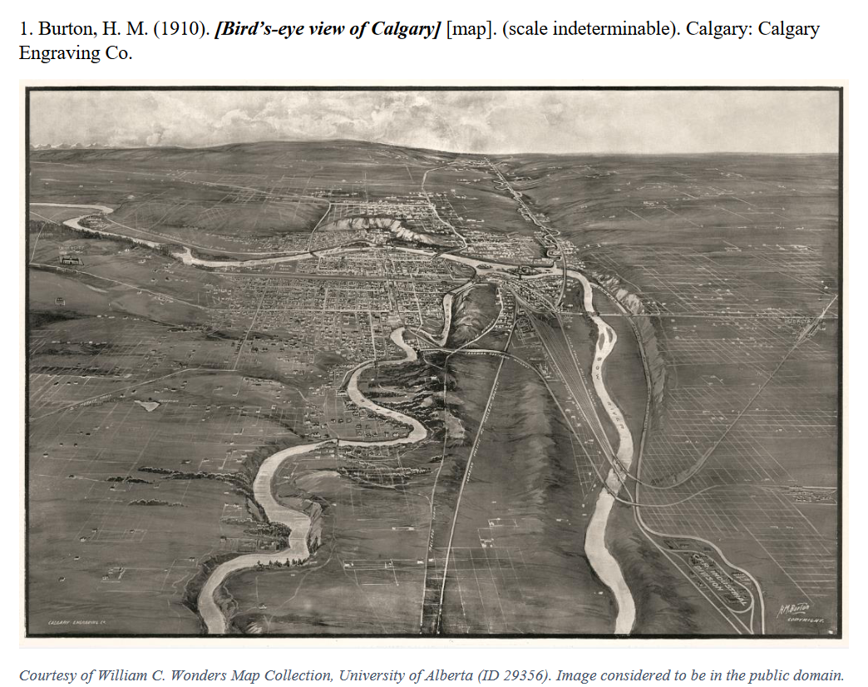
Notes:
One of those maps hanging in the office you saw in the previous photograph was this one… it shows the entire city of Calgary as it appeared in about 1910.

Slide 34
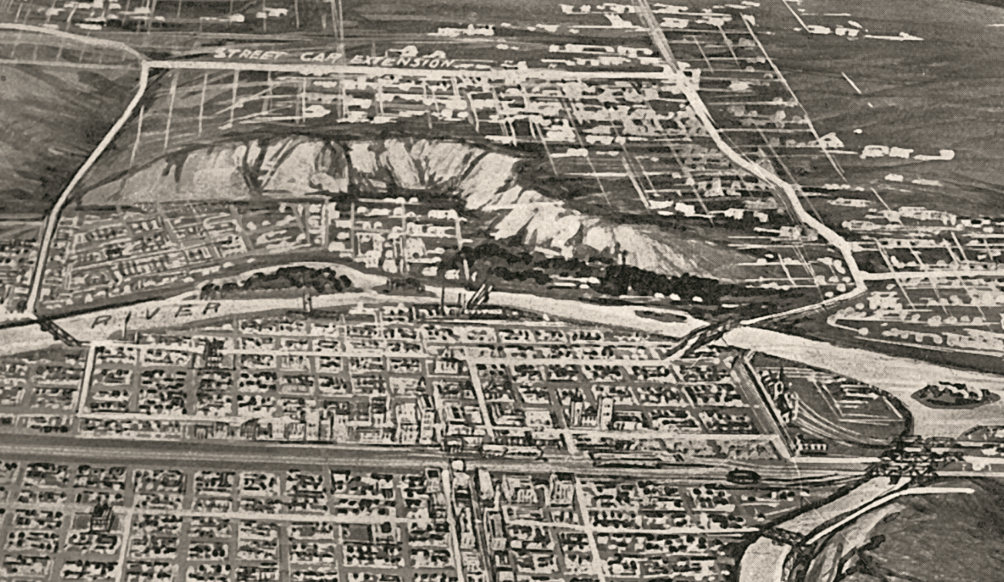
Notes:
If you zoom in on the image, you can make out downtown Calgary, the Bow River, Princes Island, and the railway tracks…

Slide 35
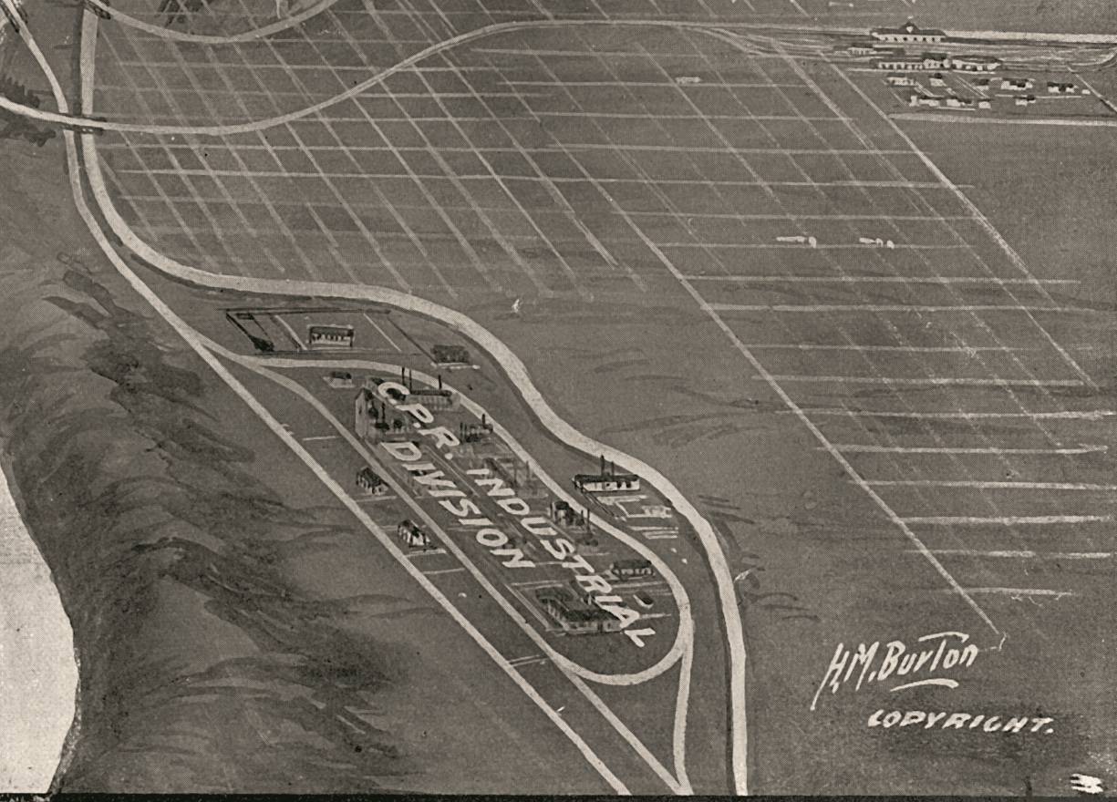
Notes:
The view was painted by Harry Marriott Burton, a trained British artist who lived in the city for several years producing views for the real estate industry. This close up shows the CPR industrial division in the southeast which had been recently developed… and which was a magnet for proposed real estate developments.

Slide 36
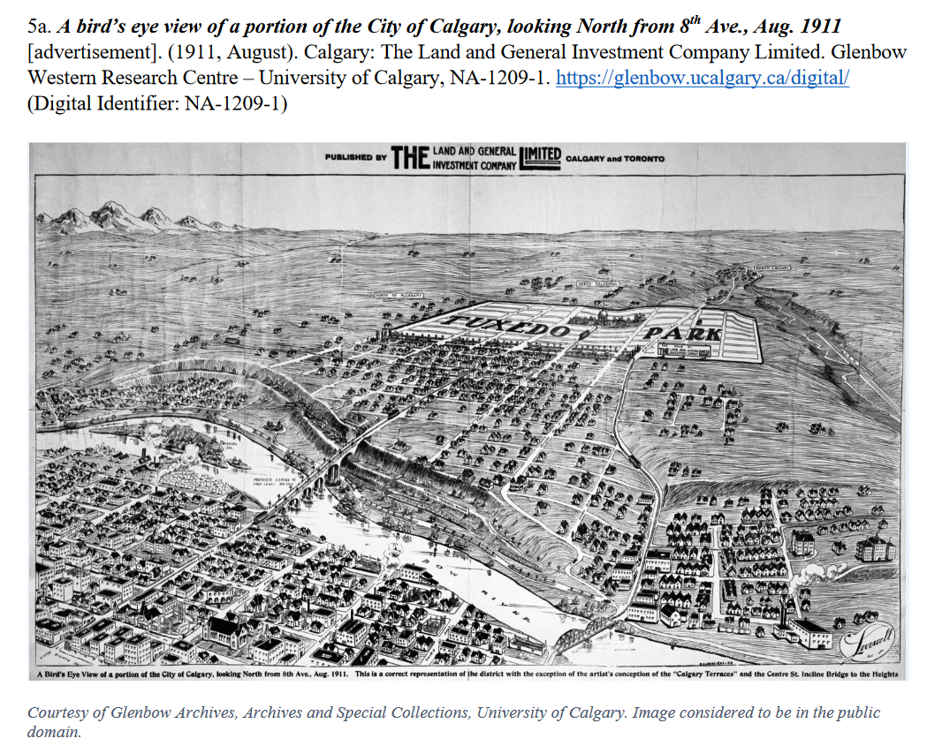
Notes:
Here’s another Calgary advertisement containing a view promoting the Tuxedo Park subdivision… now considered part of the inner-city.

Slide 37
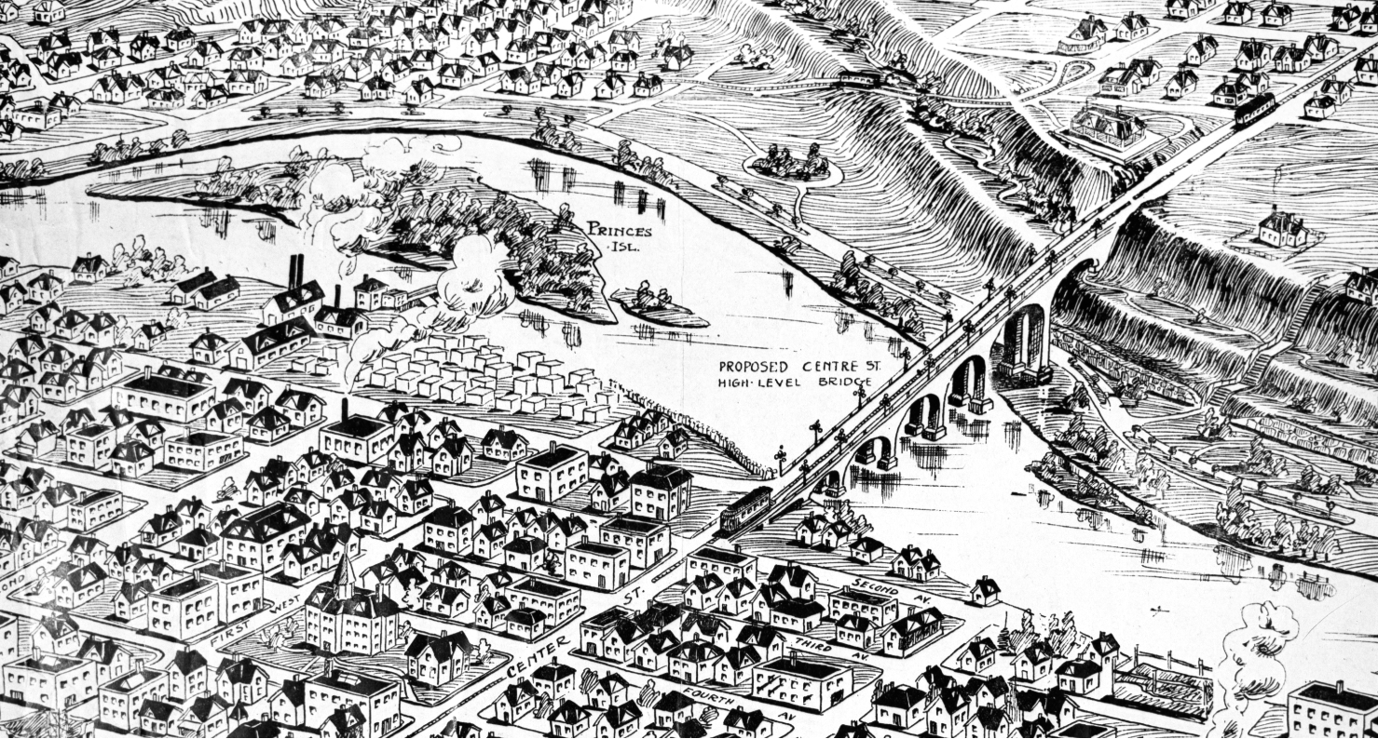
Notes:
A close-up of downtown shows some remarkable details… you can clearly see street names and buildings located in the city’s downtown… and the “Proposed” Centre Street bridge.

Slide 38
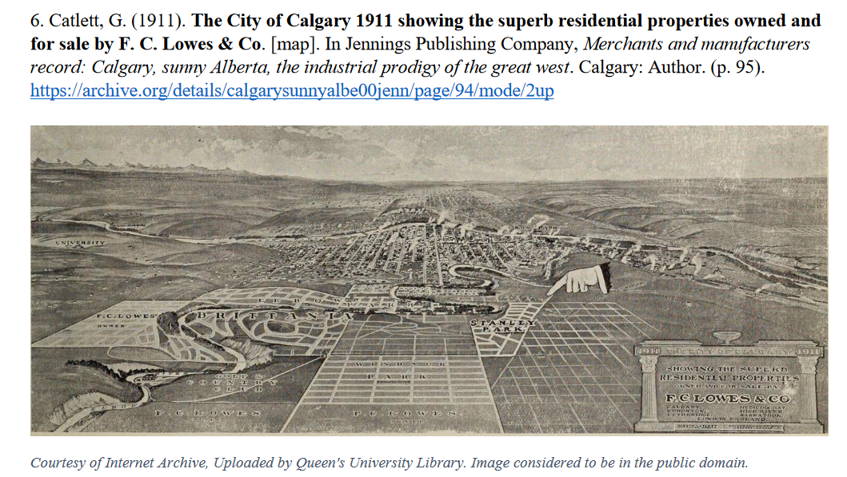

Notes:
Here’s a view of Calgary by Gibson Catlett… used to advertise subdivisions for sale by F. C. Lowes & Company… the biggest real estate developer of the day.
Note the “pointing finger”… also known as a “manicule”… these often appeared in advertisements and other signage of that era.

Slide 39
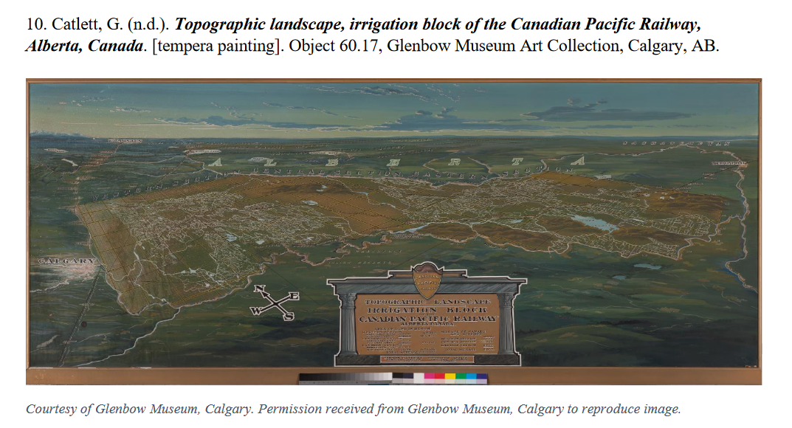
Notes:
Here’s an extremely large Catlett painting of the Canadian Pacific Railway’s Irrigation Block lands… located between Calgary and Medicine Hat… the painting was likely used for CPR exhibits.

Slide 40
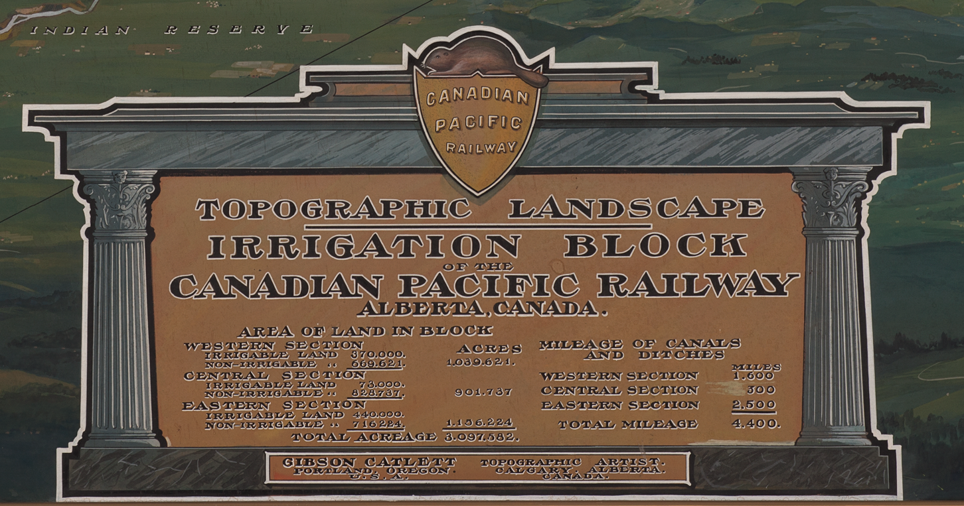
Notes:
A close-up of the painting’s label… indicating the artist name as being Gibson Catlett.

Slide 41


Notes:
Another close-up of the area around Brooks, Alberta… providing a sense of the detail in the painting…

Slide 42

Notes:
Here’s a view of Medicine Hat… pointing to the location of a proposed development called Ashton Place.

Slide 43

Notes:
And here’s one showing Chestermere Lake east of Calgary... an irrigation reservoir at the time.

Slide 44

Notes:
Lastly, this view shows Edmonton in the lower part of the image… and what was then a separate city called Strathcona in the upper-part. You can see the Legislature building, river valley, the high level 9th Street bridge, Whyte Avenue and the University of Alberta grounds…

Slide 45

ACMLA Bulletin Article
Number 164, Winter 2020
https://opus.uleth.ca/handle/10133/5704
Notes:
All of these views and many more are shown and described in this article I wrote for the ACMLA Bulletin in 2020.

Slide 46
Part III
The Life & Works of Real Estate Landscape Artist Gibson Catlett
Notes:
Which brings me to what I did during my six-month leave… which was to focus specifically on the artist and businessman Gibson Catlett…

Slide 47


The Life & Work of Gibson Catlett (1866-1935)
Gibson Catlett. Miami Herald Sun (1925, March 8)
Gibson Catlett. National Real Estate Journal (1926, April 19)
Notes:
Catlett was born in the small village of Catlett, Virginia - which is near Washington, D.C. – to an affluent family of Virginia planters… the term “planter” refers to the first European colonists in Virginia. I didn’t find out much about his early life… but in a 1923 interview, he said that painting and sketching were among his early boyhood interests.
The images you see here were from the 1920s when Catlett’s paintings were in high demand and he had studios and offices in both Chicago and Miami, Florida.

Slide 48


Early Career as a Newspaper Publisher-Advertiser (ca. 1893-1905)
Bamberg Herald (Bamberg, S.C.), (1900, February 1)
Kansas City Journal, (1897, October 1)
Notes:
As a young man, Catlett was trained in journalism and became involved in book publishing and advertising… which saw him frequently travelling and moving to different cities… New York City, Philadelphia, Atlanta, Columbia South Carolina, and other locations…
As far as his personal life, Catlett was married in 1894 to Josephine Griffin… and they had one child together named Elizabeth who was born in 1897.
Today Catlett would be thought of as a “city booster” or promoter… proponents of boosterism made extravagant predictions for communities in the hope of attracting more residents and inflating the prices of local real estate. [Wikipedia].
Catlett’s travels saw him make his way west to Dallas, Texas in 1905 and by 1906 he had reached California.

Slide 49

Real Estate Landscape Artist - Los Angeles, California (1906-1908)
Los Angeles Herald advertisement (1908, July 12)
Notes:
According to that 1923 interview, it was while in Los Angeles that the idea of painting cities came to Catlett after he’d spent years in the advertising business… He’d sketched and painted many small areas and, from this, thought of spreading whole cities on canvas.
Catlett wasn’t the first or only person doing this type of work in Los Angeles at the time… BUT, promoter that he was, he claimed later in life that he was the originator of what he called “Real Estate Landscape Painting.”

Slide 50

Searchlight, Nevada (1906), Gibson Catlett, Illustrator
https://www.pbagalleries.com/view-auctions/catalog/id/575/lot/188261/
Notes:
This view of mining town Searchlight, Nevada was the earliest Catlett view that I was able to locate… I found it within a real estate advertising booklet.

Slide 51

Map Artist For The Oregon-Washington Railroad & Navigation Co. - Portland, Oregon (1909-1910)
Kelso, Washington (1911), Gibson Catlett, Artist.
Image: Courtesy of Cowlitz County Historical Museum
Notes:
As he often did, Catlett moved to wherever there were new opportunities in real estate development… in 1909 he made his way up the coast to the Portland, Oregon in the Pacific Northwest and signed on with the Oregon-Washington Railroad as their map artist.
This was the last move that his wife Josephine would make with Catlett… she left Portland and took their daughter back to her family home in Massachusetts...
Their marriage ended in about 1918… legal notices his wife placed in newspapers accused him of “abandoning” their marriage.

Slide 52

Hood River, Oregon (1910)
Image: Courtesy of Jacob Ybarra, Bisnett Insurance, Hood River, OR
Notes:
Here’s a 9-foot wide painting that Catlett and artist Henry Epting created for the Hood River Realty Company showing Hood River, Oregon with Portland far off in the distance. It’s on display at the Bisnett Insurance office in Hood River…

Slide 53

Image: Courtesy of Jacob Ybarra, Bisnett Insurance, Hood River, OR
Notes:
A closer view of part of the painting… provides a sense of its incredible detail.

Slide 54

Image: Courtesy of Jacob Ybarra, Bisnett Insurance, Hood River, OR
Notes:
…and vibrant colours.

Slide 55


Image: Courtesy of Jacob Ybarra, Bisnett Insurance, Hood River, OR
Notes:
Included were a copyright statement… and Catlett’s logo.

Slide 56




Painter of Cities for Railroads and Large Real Estate Operators – Canada (1910-1914)
The Uplands, Victoria, British Columbia (1911) Link
London Advertiser (1914, March 7)
Link
Gibson Catlett Letterhead (n.d.)
Link
Halifax, Nova Scotia (1913) Link
Notes:
Catlett and many other Americans made their way into Canada in 1910 when they got wind of our real estate boom… as mentioned, he set up offices in Calgary… later in Montreal… and hired professionally-trained artists to assist him in his work.
He travelled from coast to coast creating these views… from Victoria in the West to Halifax in the East.

Slide 57


San Francisco, California & the Panama-Pacific Exhibition (1915-1917)
https://archive.org/details/souvenircanadian00pana
Gibson Catlett, exhibit rooms, Flood Building, California Digital Library
Notes:
One of his clients was the Canadian government itself… he was commissioned to create a massive 70-foot by 9-foot topographic landscape painting of the entire country of Canada which was to incorporated into the Water Power Exhibit in the Canadian Building at the Panama-Pacific Exposition of 1915 in San Francisco.
Catlett stayed in San Francisco and continued to create huge views of California… two of which you can see on the right.

Slide 58

Establishment of Gibson Catlett Studios, Chicago (ca. 1919)
From advertisement in Miami Herald (1925, March 8)
Notes:
In about 1919, he moved to Chicago and established his studios there where he remained for many years… though he would travel and work extensively throughout the United States. Catlett was what we would today call a ‘snowbird’ as he left Chicago in the winter for warmer climates…

Slide 59

Miami & the Florida Real Estate Boom (1920-1926)
Inside the real estate offices of Buchanan & Burton - Miami, Florida (March 18, 1926).
Source: State Library & Archives of Florida, RC03586 .
Notes:
One of those warm places was Florida where an unprecedented real estate boom took place in the 1920s… Catlett opened a second studio in Miami during this time. Here we see a 1926 photograph of a Miami real estate office displaying enormous Catlett paintings of “Everjune Gardens” on the upper-left left and right side of the photo.

Slide 60

Illustration of large Gibson Catlett Studios cycloramic real estate landscape painting, possibly the planned Florida Riviera development, St. Petersburg, Florida. From advertisement in Miami Herald (1925, March 8).
Notes:
As he became more successful and demand grew for his views, Catlett’s paintings also grew in size… from quite large to absolutely humungous!
One picture of a development in St. Petersburg, Florida was reportedly eight-feet-high by one-hundred-and-twenty-feet long and was made in three separate sections.
It was displayed in a so-called “cycloramic” arrangement meant to enable an individual to stand in the centre of an auditorium and, in turning from left to right, gain a conception of what an entire property would look like once completed.

Slide 61

Gibson Catlett’s Studiogram [Advertisement]. National Real Estate Journal (1926, April 19)
Notes:
Here’s another view of that type of “cycloramic” arrangement from a Catlett advertisement…

Slide 62

Gibson Catlett's 16-foot painting of the Sequoyah Hills development in Knoxville, Tennessee on display in Sequoyah Hills office (ca. 1925). Sequoyah Hills office, Image Number N-1036 , Thompson Photograph Collection, C.M. McClung Historical Collection, Knox County, Tennessee Public Library.
Notes:
This is a photograph of a real estate sales “event” in Knoxville, Tennessee – complete with a brass band – that featured a Catlett painting of a new development called Sequoyah Hills.

Slide 63

Thompson Brothers, photographer. 1926. Sequoyah Hills. Thompson Photograph Collection, C.M. McClung Historical Collection, Knox County Public Library. Image Number N-2034.
Notes:
Here’s that same view on a roadside billboard… note the word “RESTRICTED” on the signage… this was a kind of “code word” meaning that it was an exclusive neighborhood “segregated” by economic class and race.

Slide 64


Texas and the Gulf Coast (1926-1927)
Amarillo Daily News (1927, March 15)
Day, Donald. Big Country: Texas. New York: Duell, Sloan & Pearce, 1947.
Notes:
All booms inevitably end in busts… and when the Florida bubble imploded in 1926, Catlett moved on as well… this time finding new opportunities in Texas and Louisiana.
The author of the highlighted text on the right… seemed to be of the opinion that Catlett’s paintings were a promotional sales mechanism meant to extract money from gullible real estate investors… there was probably some truth to that… especially considering real estate prices came crashing down across the country a few years later during the 1929 depression.

Slide 65


Oakwood Memorial Park (High Point, NC) painting by Gibson Catlett Studios (ca. 1926) which indicated studios located in Chicago and San Antonio, Texas. Courtesy of High Point Museum, High Point, NC.
Notes:
Catlett sometimes took on work for “non-traditional” real estate clients as demand for his work declined… an example of which was the Oakwood Memorial Park cemetery in High Point, North Carolina – seen here. He also did work for golf courses and resort-style developments.

Slide 66

The Last of Catlett’s Real Estate Landscape Paintings (1928-1930)
Catlett, G. (1928). City of Chicago, showing proposed development of 1933 World's fair ground and buildings [photograph of painting]. UIC Special Collection (Century of Progress International Exposition [1933-1934 : Chicago, Ill.]). Series 1 -- Catlett, Gibson, ca. 1933-1934 Box 92 Folder 1-2781.
Notes:
Real estate sales suffered during the Great Depression and Catlett’s opportunities for creating views diminished… the painting of Chicago seen here was done to promote the Chicago World’s fair. NOTE that it includes an airplane on the left-hand side… better quality aerial photography was also an emerging competitor for viewmakers like Catlett to contend with…
When his career was all said and done, Catlett was in the view-making business for about 25 years, and in that time, he estimated he’d produced more than 3,000 pictures… for locations all over North America.
In May, 1935, Catlett’s daughter Elizabeth passed away… and, in August of that same year… Catlett himself died at his family estate in Virginia from arsenic poisoning… apparently self-inflicted.

Slide 67

Images of Selected Works by Topographic Artist and Businessman Gibson Catlett
Gibson Catlett's Real Estate Landscape Paintings
Notes:
This map I created gives you an idea of the more than 50 locations that I’ve documented as having views created by Gibson Catlett …. I gathered background information for each of them as well.

Slide 68

ArcGIS “Story Maps”
Gibson Catlett (1866-1935)
  Gibson Catlett was a prolific American artist who specialized
  in real estate landscape paintings used as advertisements.
Gibson Catlett's Real Estate Landscape Paintings
    Images of selected works by topographic artist and businessman Gibson Catlett (1866-1935).
H. M. (Harry Marriott) Burton
  H. M. Burton was one of Calgary, Alberta's most prolific real estate artists during the city's real estate boom of the 1910s.
Notes:
You can see the many surviving views and descriptions in a “Story Map” I created to display them… as well as a second storymap that details Gibson Catlett’s life and work.
A third one provides information about another artist named H. M. Burton who was active in Calgary during Southern Alberta’s boom.

Slide 69

The End
Notes:
As you can see here… signs and billboards still play an important role in selling real estate today… 110 years after the Lethbridge bird’s eye view painting was created!
And that’s it… thanks everyone for taking the time to listen to my talk!

