Slide 1
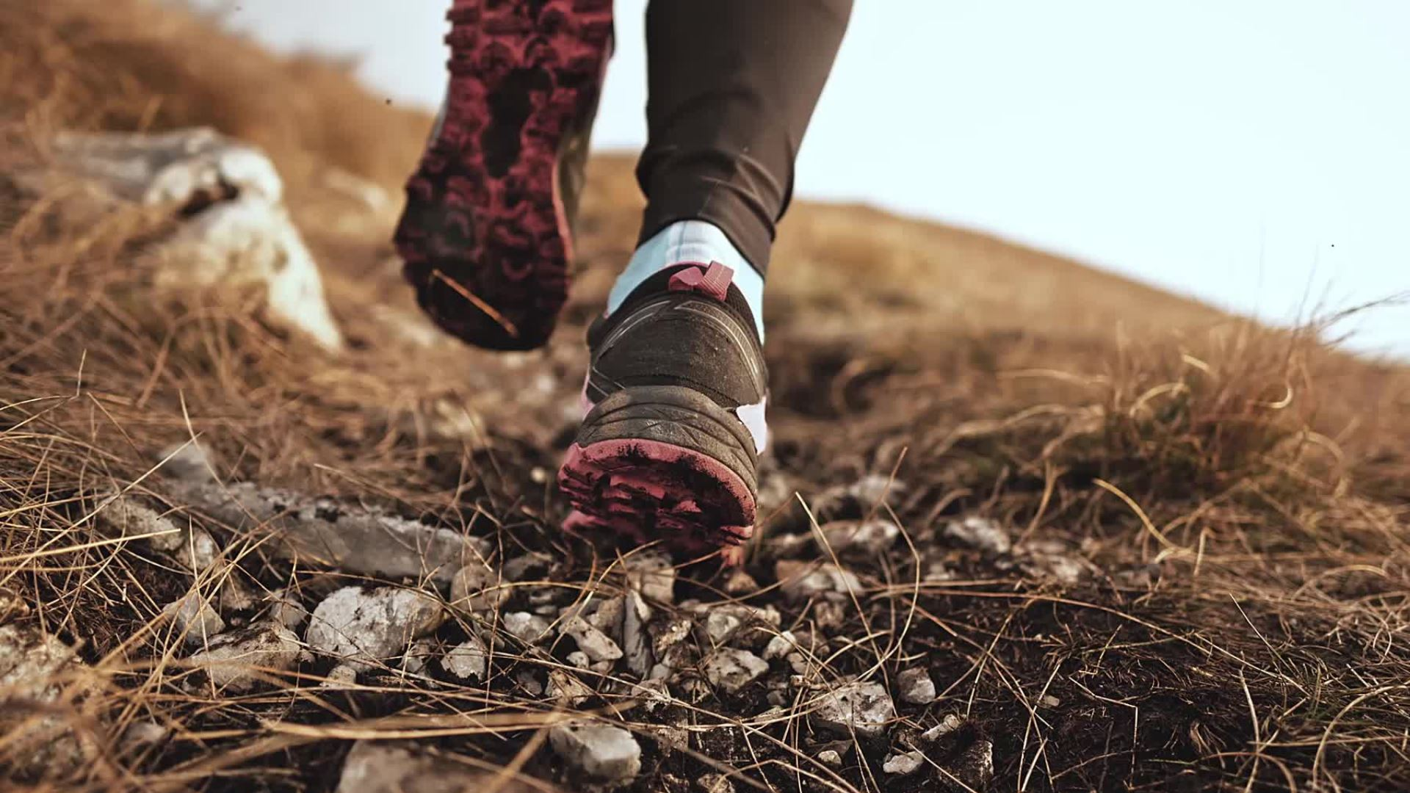
Trace A Path Assignment

Slide 2
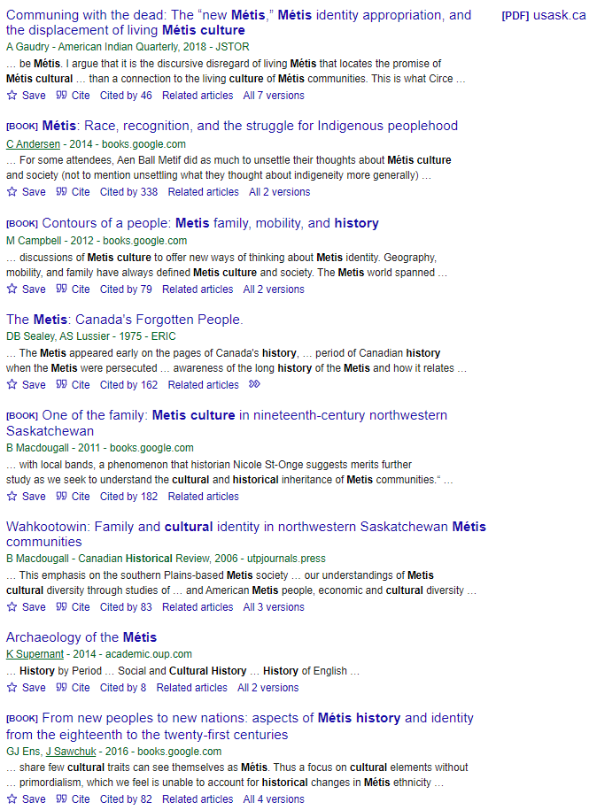
First Search: "Metis History and Culture" on Google Scholar
Noticed Saskatchewan appearing in two articles
Pattern of the word 'identity' alongside peoplehood
See the potential of the resources and how I can focus the point both on the website given in class and what I can search
Come to the realization that I want to focus more on newer resources and educating students about how to be properly informed of Metis history and culture

Slide 3
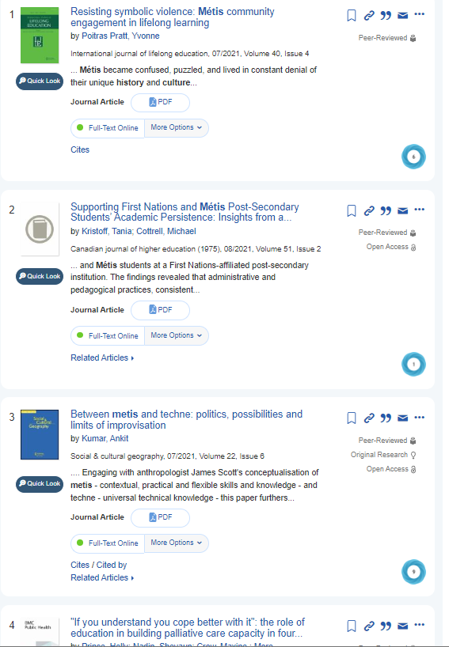
Second Search: "Educational Resources About Metis History and Culture": ULeth Library Database
Had a difficult time wording the second search to fit exactly what I want to research
Not fitting the sort of academic resources that I am looking for – (need to have the key words school curriculum?)
Resources are similar to original search
Went back to original website and observed how they are linking themselves to educational resources and teaching in schools
What exactly should I be researching and should I be using a specific database or key words about Metis culture - considered using pedagogy, modernity, and educational ethnography of the Metis

Slide 4
Second Search Tangent
Resisting Symbolic Violence: Métis Community Engagement in Lifelong Learning
  Spoke of education becoming an aspect in Metis lives in 1971 in their first ever conference 'determining our destiny' by the Metis Nation of Alberta
  Not the sort of information I want to focus on when thinking about Metis culture and identity as it is explained in the Gabriel Dumont Institute Website
  Began thinking about the interests I found when researching and going through the website provided in class – thought about Indigenous children and play, and the child-rearing practices that they implemented inside of their own culture

Slide 5
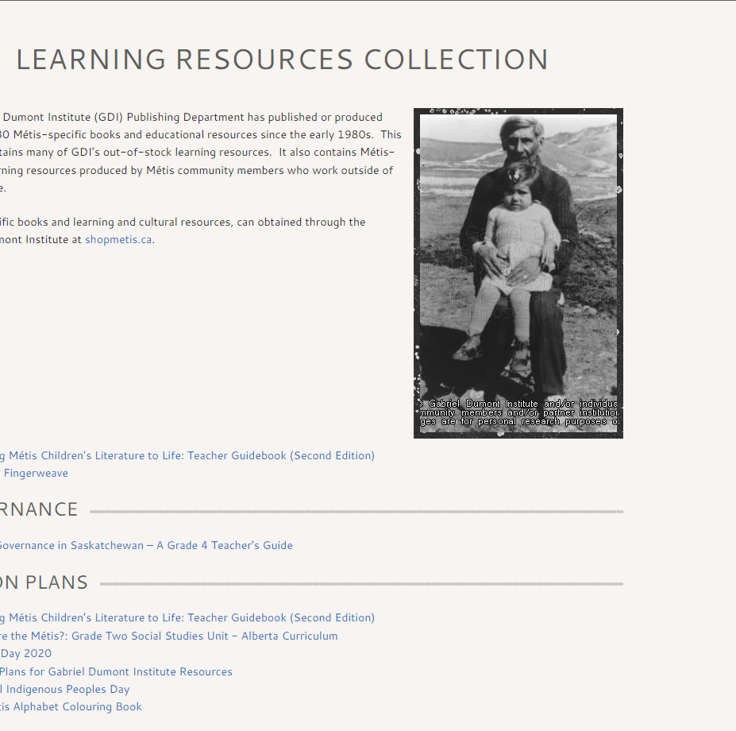
Epiphany
Decided to focus on the aspect of storytelling and the incorporation of Metis children's literature in schools
  Affirmed my interests of how the teachings of Indigenous culture can be put forth to others
Inspiration coming from learning resources on the Gabirel Dumont Institute website
  Websites focus is on educating others by providing multiple resources and strategies to encourage learning and understanding

Slide 6
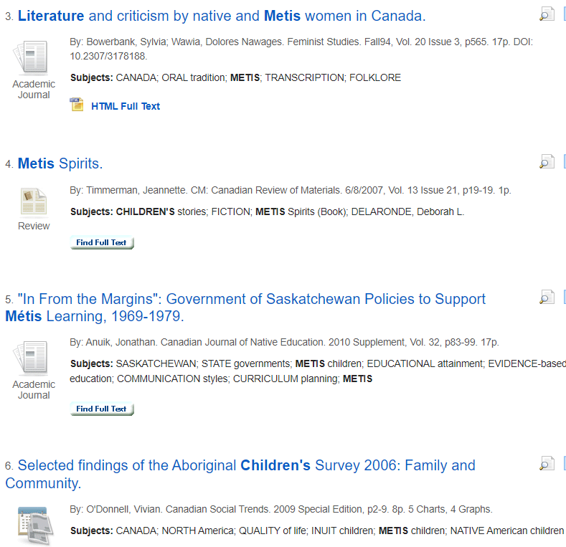
Third Search: "Metis Children's Literature in Schools": ULeth Library Databases by Subject – Indigenous Studies
Chose the database: Bibliography of Indigenous Peoples in North America
  Gave examples of Metis children's literature
  Continuous resources and articles from Saskatchewan
  Still mainly focused on culture and inclusion
  Wondering if I should have focused my topic on Gabriel Dumont – easier to find resources? Should I have focused on the history of the Metis alone?
  Another Database: North American Indian Thought and Culture
    looked promising, but hard to access and research and had no information on Metis

Slide 7

Third Search Tangent
Articles I tried to access through the ULeth Library:
"Metis families: Study Paper"
Every resource was unavailable. The difficulty of trying to find relevant papers or articles that reference the Metis and the connection to education in schools is difficult – is culture and storytelling something that is not researched or implemented? How am I able to find a resource that connects to the website and its direct teachings in a classroom in an article alone?
"Metis History Will Gain Importance in School Systems"
"Louis Riel and Metis Literature"

Slide 8
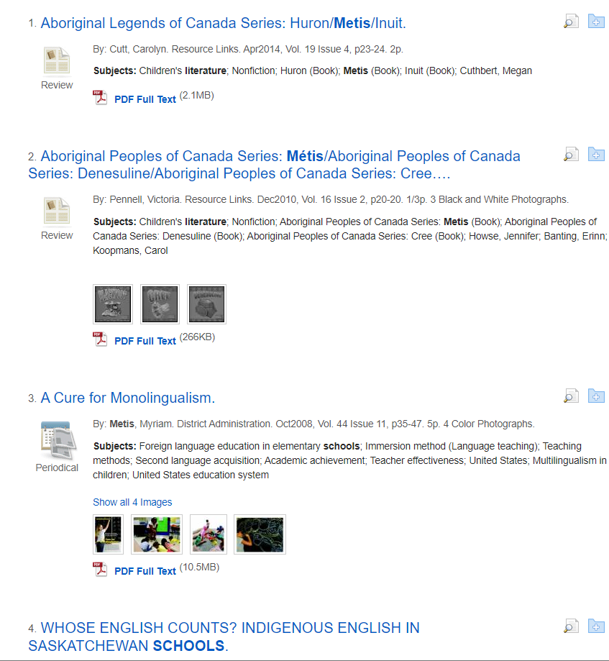
Fourth Search: "Metis Children's Literature in Schools": ULeth Library Databases by Subject – Education
Database: Education Research Complete
  Less examples of children's literature
  Findings of Saskatchewan related articles
  More argumentative of language instead of literature
  Articles appear to have information relevant to class teachings and the identity Metis struggle to find and implement into society – why does the society not include children?

Slide 9
Fourth Search Tangent
"From School in Community to a Community-Based School: The Influence of an Aboriginal Principal on Culture-Based School Development."
  Unavailable
  Seemed to be spot-on to my research so I went onto Google and found the exact same article through the University of Calgary (This journal is from the University of Saskatchewan)
  Found the same article
  Was a study of three Indigenous groups in a small area and the promotion of Canadian Aboriginal schools
  Love the idea of having a smaller focus such as three Indigenous groups for a more authentic interpretation of culture and identity affecting their lives – relates to website and the focus of storytelling and outside resources one cannot usually achieve in an academic standpoint

Slide 10
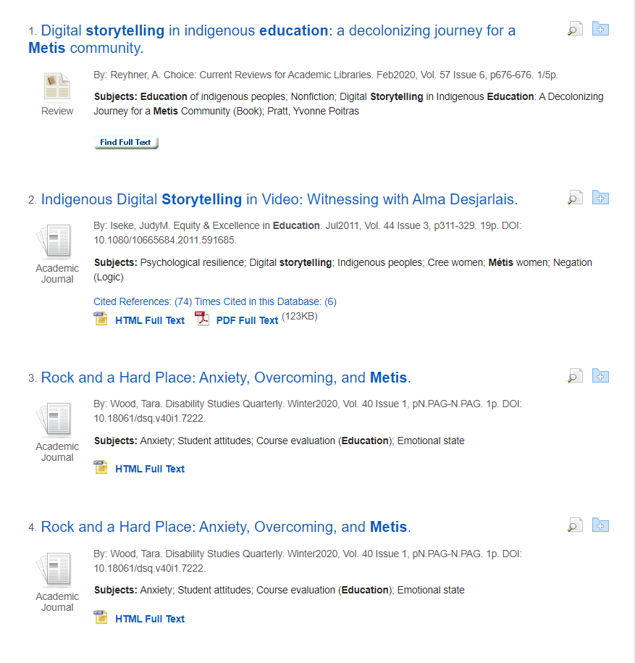
Fifth Search: "Metis Storytelling in Education": ULeth Library Databases by Subject – Education
Database: Education Research Complete
Can see indigenous digital storytelling articles
Book of Northern Saskatchewan
Articles:
"Rock and a Hard Place: Anxiety, Overcoming, and Metis"
  No Metis resources
  I believe that in the article I find I need to have one backed up by genuine Aboriginal resources that authenticate the research put forth
"Of Metis and Madness in the Elementary School"
  unavailable

Slide 11
Fifth Search Tangent
"Indigenous Digital Storytelling in Video: Witnessing with Alma Desjarlais"
  Did not think I was going to click on this article
  In depth article and research about the benefits of digital storytelling in schools and the accompaniment of elders and real stories
  Has 74 Cited references and was created in July 2011
  Access to the article is 18 pages
  Linked words are psychological resilience, digital storytelling, Indigenous peoples, Cree women, Metis women, negation (logic)
  All resources are aboriginally based and extensive
    Tangent to Metis resources found in the ULeth library – articles
    Follows previous finding of direct teachings in order to implement experience of culture and identity – strong article that almost succeeds in me trying to find something relating to storytelling of Metis culture through literature in education– should I focus on literature?

Slide 12
Fifth Search Tangent Continued
Chose to keep an open mind of finding an article that relates to storytelling and if it somehow connects to literature for children then I will accept it – too many key words that are broadening my research
Found resource titled "Importance of Metis Ways of Knowing and Healing Communities"
  Elder's stories and communication and the importance of elders in research
  Founded by multiple Canadian resources – just like the website!
  Went to articles citations – similar to previous article (a good thing)
  Chose to view resources citations – clicked on "The Truth About Stories: A Native Narrative"
    Novel – did not go into more depth
  Searched Metis Storytelling In Elementary Education
    More direct focus on teaching of storytelling in schools to back up previous thought – (what harm can it do?). The website being compared focuses specifically on resources for teachers to implement in classrooms for their students – I am determined to find some sort of link to ease my mind that Metis culture is being taught in schools and that teachers cannot rely on the Gabriel Dumont Institute Website to provide all information.

Slide 13
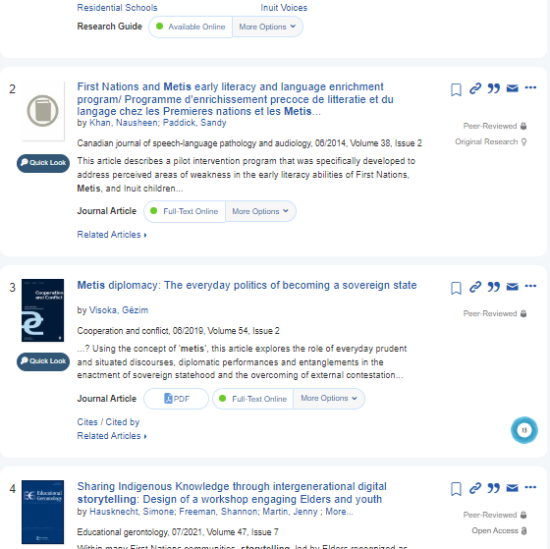
Sixth Search: Metis Storytelling in Elementary Education
Clicked on "First Nations, Metis, and Inuit Perspectives in K-12 Literature"
  Took me to CURR LAB. AMAZING! BUT... Not an article?
  Went to article: "Sharing Indigenous Knowledge Through Intergenerational Digital Storytelling: Design of a Workshop Engaging Elders and Youth"
    The most promising of all the articles I have found – only issue is that it is not specifically about Metis culture
    Beautiful article – concerned about the lack of specific Metis culture spoken about in schools
    Talks of digital storytelling, elders, and implementing Indigenous knowledge into education
    Went to references
      Found Canadian Council Learning - Redefining How Success is Measured in First Nations, Inuit, and Metis Learning
    JACKPOT – however – not a part of the University of Lethbridge Library
    https://www.afn.ca/uploads/files/education/5._2007_redefining_how_success_is_measured_en.pdf

Slide 14
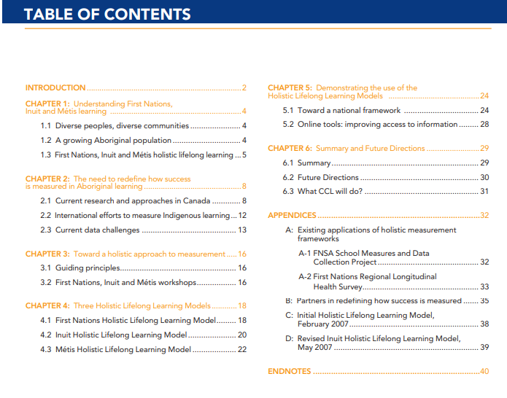
REDEFINING HOW SUCCESS IS MEASURED in First Nations, Inuit and Métis Learning Handbook
Link from previously slide enforces the promotion of learning through Indigenous cultures.
Does it count as an "academic book?"
Provides models for holistic lifelong learning
Goals towards a national framework – education being implemented and accessible everywhere!
Reinforces the history and culture of Indigenous people and current approaches
  Idea for educating the past as well as future learners!

Slide 15
Curriculum Laboratory – First Nations, Metis and Inuit Perspectives in K-12 Literature: Indigenous Voices and Ways of Knowing
The accessibility of the curriculum lab on the University of Lethbridge library website is a notable aspect of my findings. As it is not specifically an article, I did not choose this as the final choice for the Tracing a Path assignment. However, knowing that resources are available to directly teach students about Metis culture through children's literature is important. The literature written and illustrated by Metis people brings legible resources for students and 100% accurate information.
It also relates to Bringing Métis Children’s Literature to Life: Teacher Guidebook (Second Edition) on the website as those are books recommended about Metis culture.

Slide 16
Findings
& Thoughts
Article Chosen – Sharing Indigenous Knowledge through Intergenerational Digital Storytelling: Design of a Workshop Engaging Elders and Youth
Hausknecht, S., Freeman, S., Martin, J., Nash, C., & Skinner, K. (2021). Sharing indigenous knowledge through intergenerational digital storytelling: Design of a workshop engaging elders and youth. Educational Gerontology, 47(7), 285-296. https://doi.org/10.1080/03601277.2021.1927484
Bringing awareness of culture, inclusion, seclusion, and integration of Metis cultures is the main aim I focused towards in my findings. After looking for hours, the closest article I could find to communicate Metis culture and identity being incorporated in schools was through digital storytelling which engages both elders and youth. This utilizes my initial thoughts of combining new information with old and uphold the aspect of the Gabriel Dumont Institute Website that focuses on real, outside Indigenous resources.
This article utilizes numerous references and citations that tie directly to Indigenous culture and beliefs. However, the main focus is not DIRECTLY focused on Metis culture. The struggle of finding such an article led me to lead my findings more towards Indigenous culture as a whole in Canada, and the way teachings can be utilized in the classroom. When considering the use of elders through digital storytelling, I found that this is the closest connection I could find to the website as they are both digital and can be accessible when pointed in the right direction.
The use of an article alone from the University of Lethbridge website is not the most effective way of teaching students in classrooms about Indigenous culture. From the previous examples of the curriculum lab and the handbook, having culture taught physically and through implementation is a more effective way to carry knowledge across generations. The Gabriel Dumont website has this aspect, as it is not a website that has information, and once read the learning is complete. It is constantly updated with elders and resources and gives outside examples of how to incorporate Metis learning in a classroom. Finding this article led me to the questions:
  What is the relevance one wishes to reach? It is just about researching or is it about incorporating this knowledge in everyday life?

